Slide 1
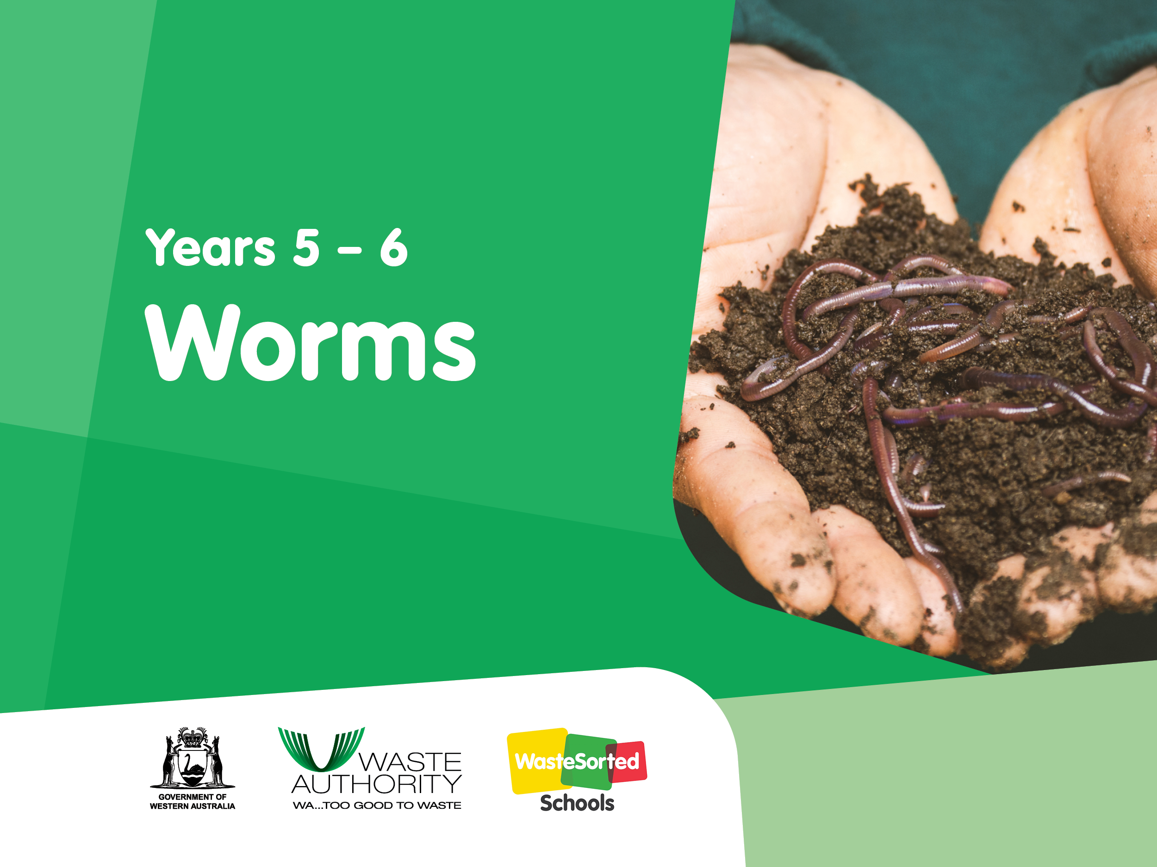

Slide 2
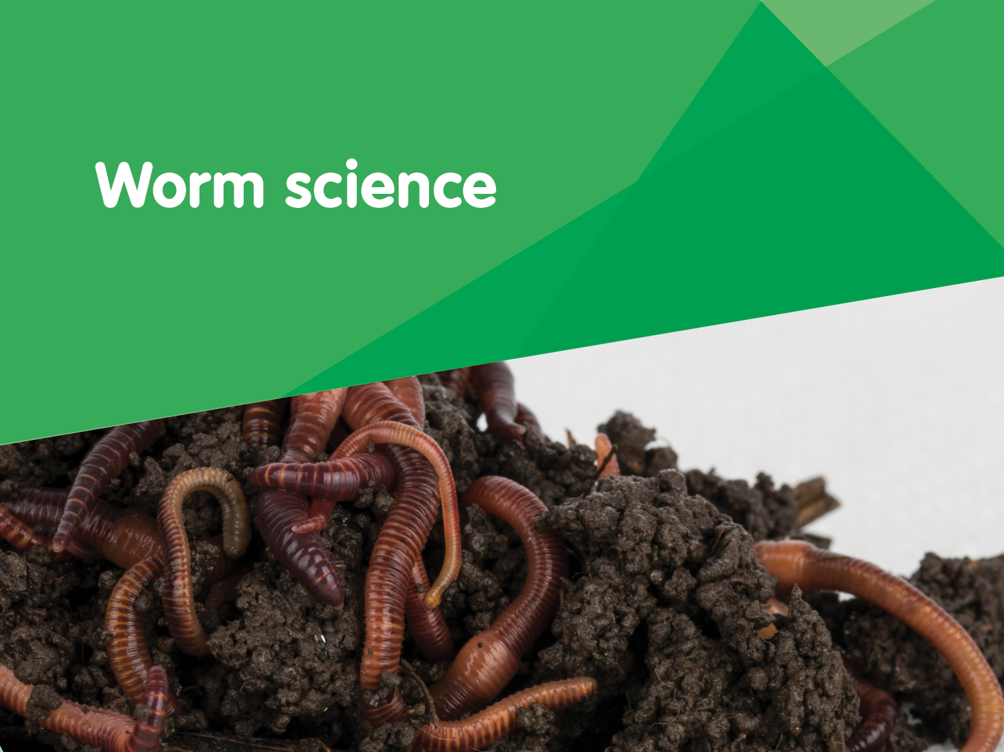

Slide 3
What do we know about worms?
Mind map

Slide 4
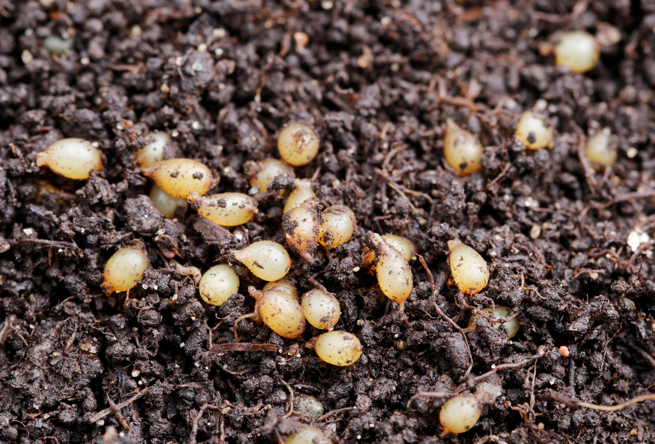
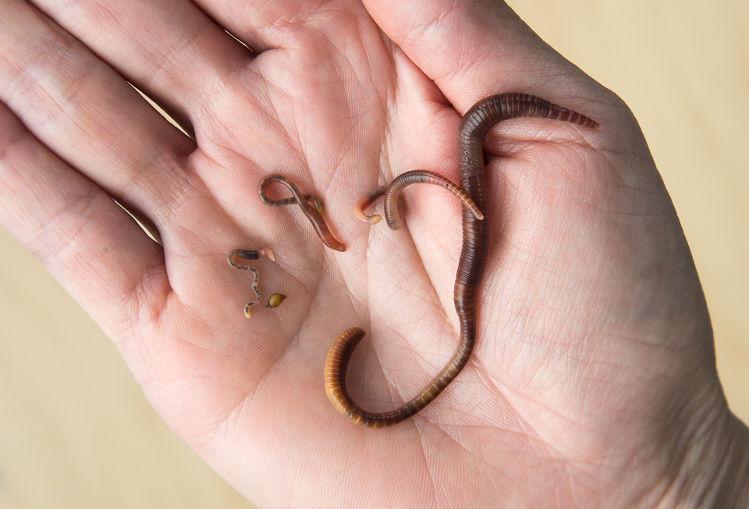

What do you think it is?
This is called
a cocoon.
Up to 20 worm eggs are held together in a protective cocoon. The hatchlings emerge and burrow into the soil, where they grow into juvenile, then adult worms.

Slide 5
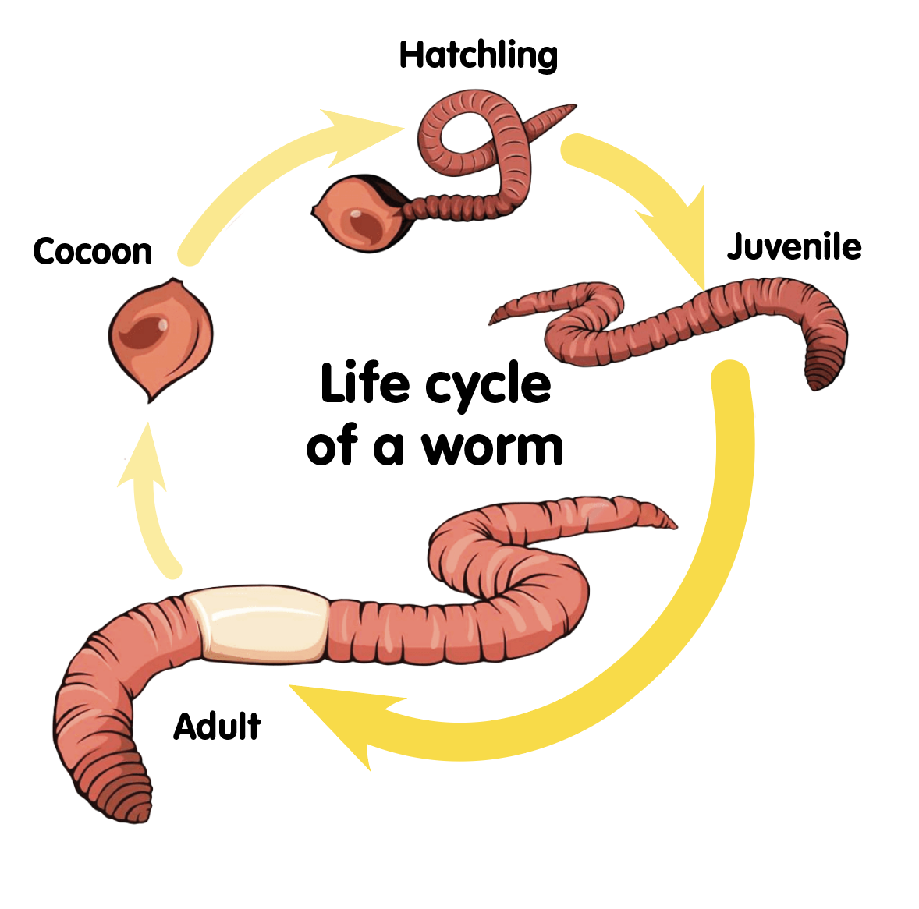
Life cycle of a worm
Cocoon: (also known as a capsule) Each cocoon can contain up to 20 eggs. They tend to be lemon shaped.
Hatchling: Looks like a mini earthworm, just smaller and paler. They begin to eat immediately after hatching.
Juvenile: Looks very much like the adults but are missing the saddle (or clitellum).
Adult: It can take a worm up to three months to grow into an adult. Adults can be easily recognised through the presence of the saddle (or clitellum).

Slide 6
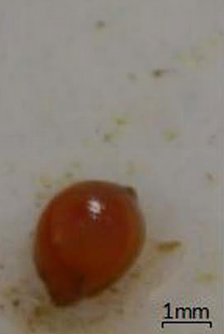
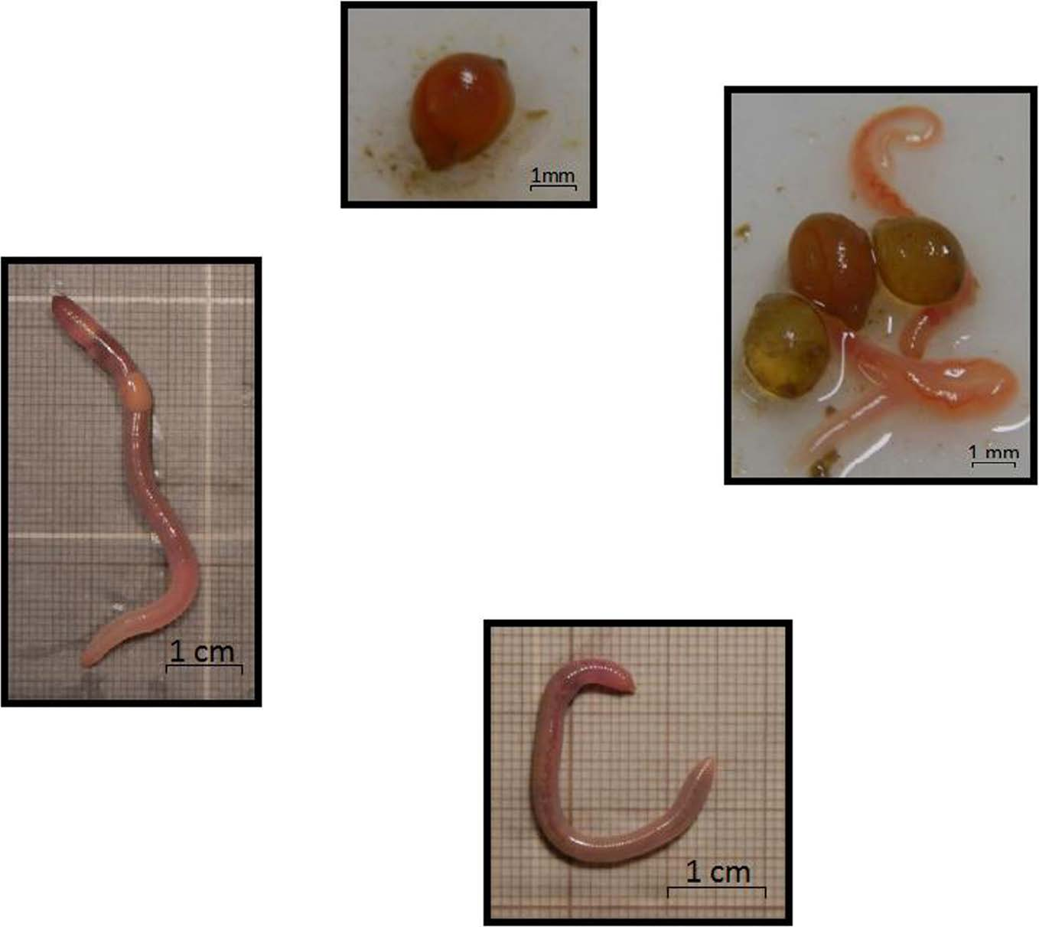
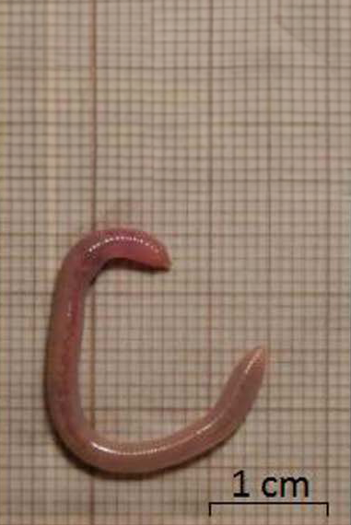
Measuring the stages of the life cycle
capsule
hatchling
juvenile
adult
Measure
Share and discuss
Use the grids and
1 mm/cm scale on the photos to estimate the length of the cocoon, hatchling, juvenile and adult.
Share and discuss your estimates with a partner.

Slide 7

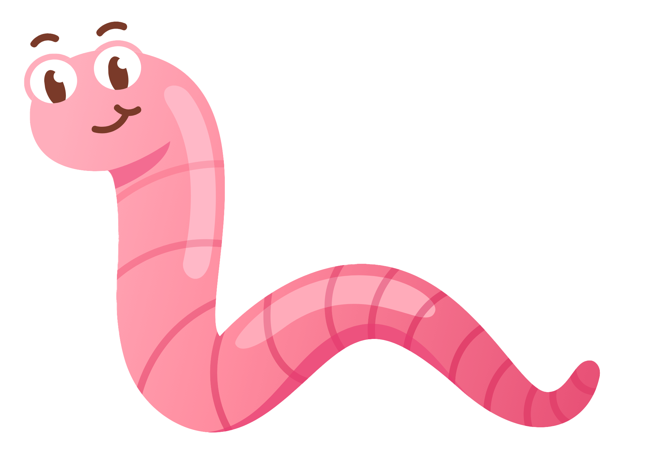
Let’s investigate
Remember, worms are living creatures. They need to be treated gently and touched as little as possible.
1. Carefully examine your worms and castings to find a cocoon, a hatchling, a juvenile worm and an adult worm.
4. Compare your measurements to those in the photos.
2. Use these to help you draw a labelled diagram of the life cycle of a worm.
5. Discuss your findings with a partner.
3. Measure the length of a cocoon, a hatchling, a juvenile and an adult worm.
Making it digital
Take a photo of a worm capsule, a hatchling, a juvenile worm and an adult worm.
Using an app of your choosing, import the photos and use them to create a labelled life cycle.

Slide 8
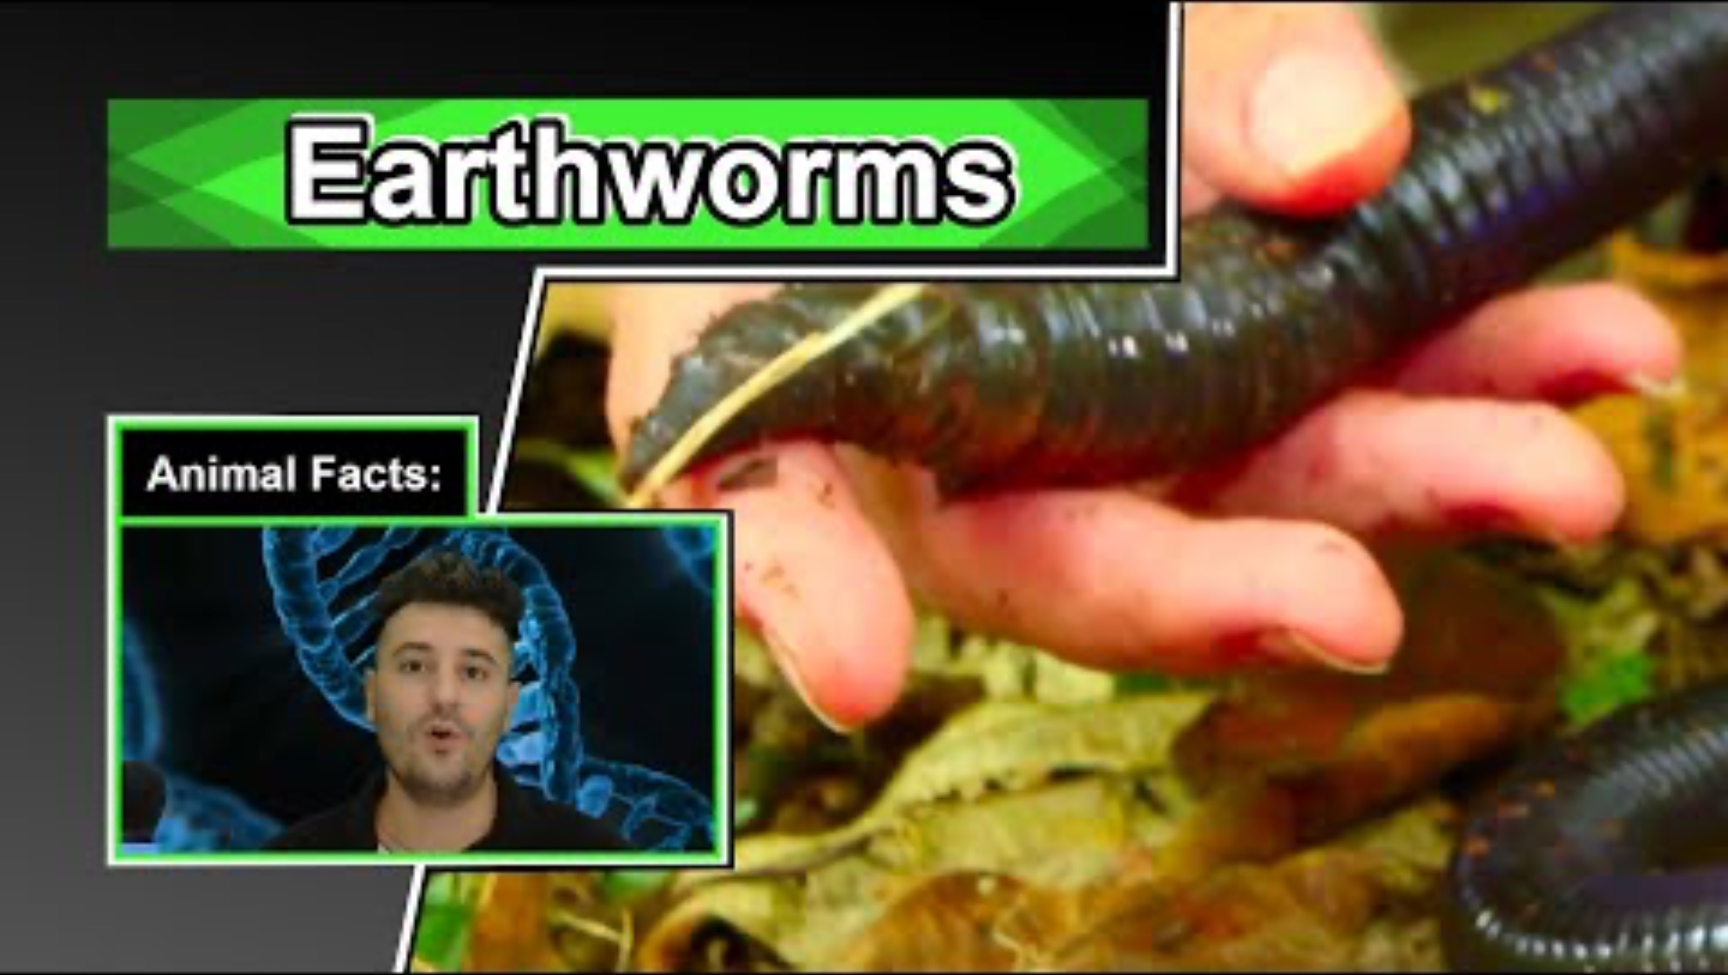
Let’s discuss
Let’s watch the video to learn some interesting facts about worms
Discussion questions:
What happens when you cut a worm in half?
What is the band around a worm’s body called?
How do worms sense light without eyes?
Name some parts of a worm’s body?
How do worms breathe without lungs?
How long can worms live?
How do worms try to escape predators?
How do worms move in the soil?
How much can a worm eat in a day?
How do worms chew?
How do worms help the soil?
Earthworm Facts | 10 Animal Facts about Earthworms - YouTube

Slide 9
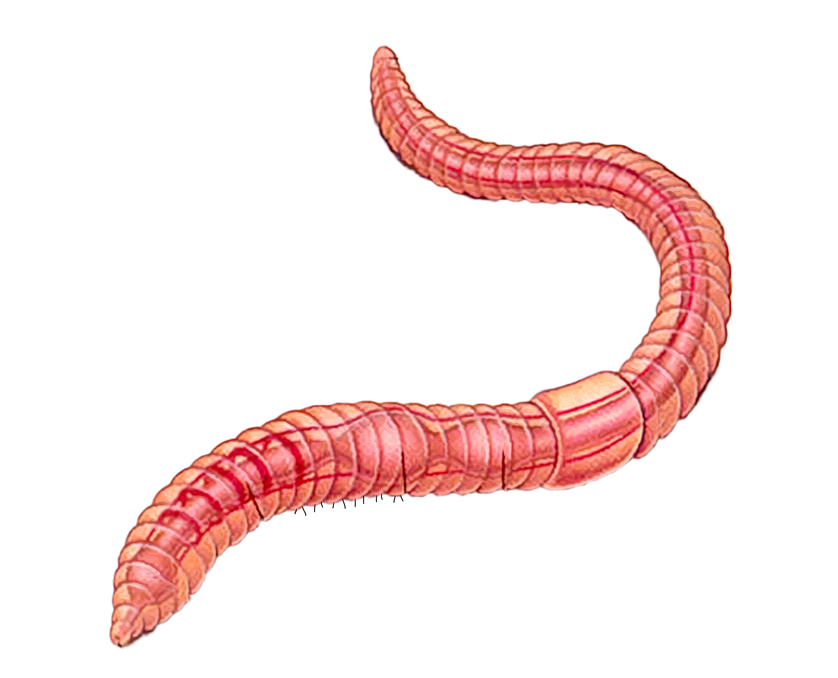
Anatomy of a worm
Click on the words to label the parts of the worm
mouth
brain
hearts
crop
gizzard
clitellum
simple intestine
anus

Slide 10
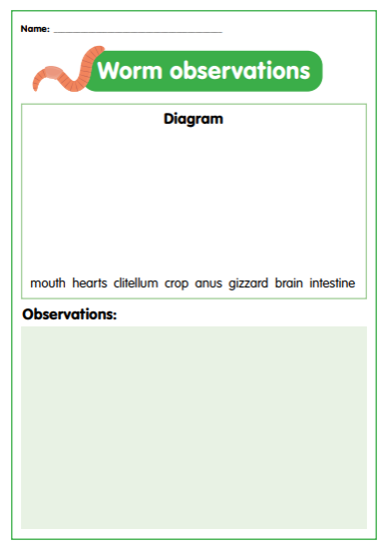
Let’s investigate
Remember, worms are living creatures. They need to be treated gently and touched as little as possible.
1. Observe the worms using a magnifying glass.
3. Record observations about the worm:
smell
colour
number of segments
can you find the worm’s head and tail?
does it have eyes, a nose, hair, or a mouth?
2. Complete a scientific drawing of your earthworm. Label the following external and internal parts on your diagrams:
mouth
hearts
clitellum
crop
anus
gizzard
brain
intestine
how does the worm’s skin feel?
do you think the worm has a skeleton?
how does the worm move?
Making it digital
Take a photo of a worm and use the text tool to add labels in the correct places.
Use a voice record function to record your observations about the worm.

Slide 11

Let’s discuss
Features and adaptations
Humans need arms and legs to move around, but worms don’t have these.
How have worms adapted their physical features to allow them to move easily in their habitat?
Humans wear sunglasses to protect their eyes from the glare of the sun.
How does sunlight impact on worms?
We know all living things respire, but worms don’t have any lungs.
How have worms adapted to be able to breathe when underground?

Slide 12

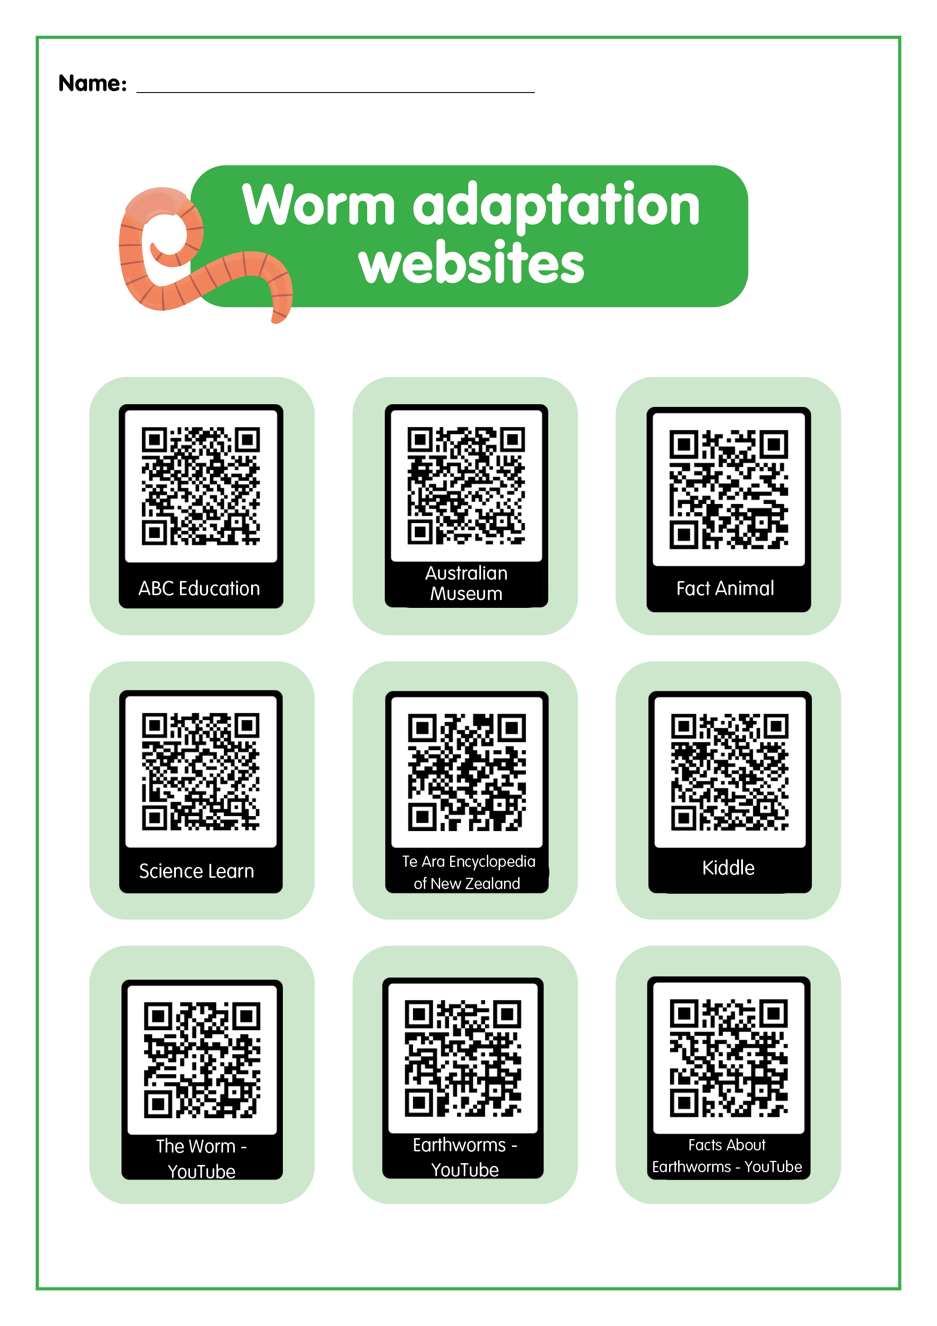
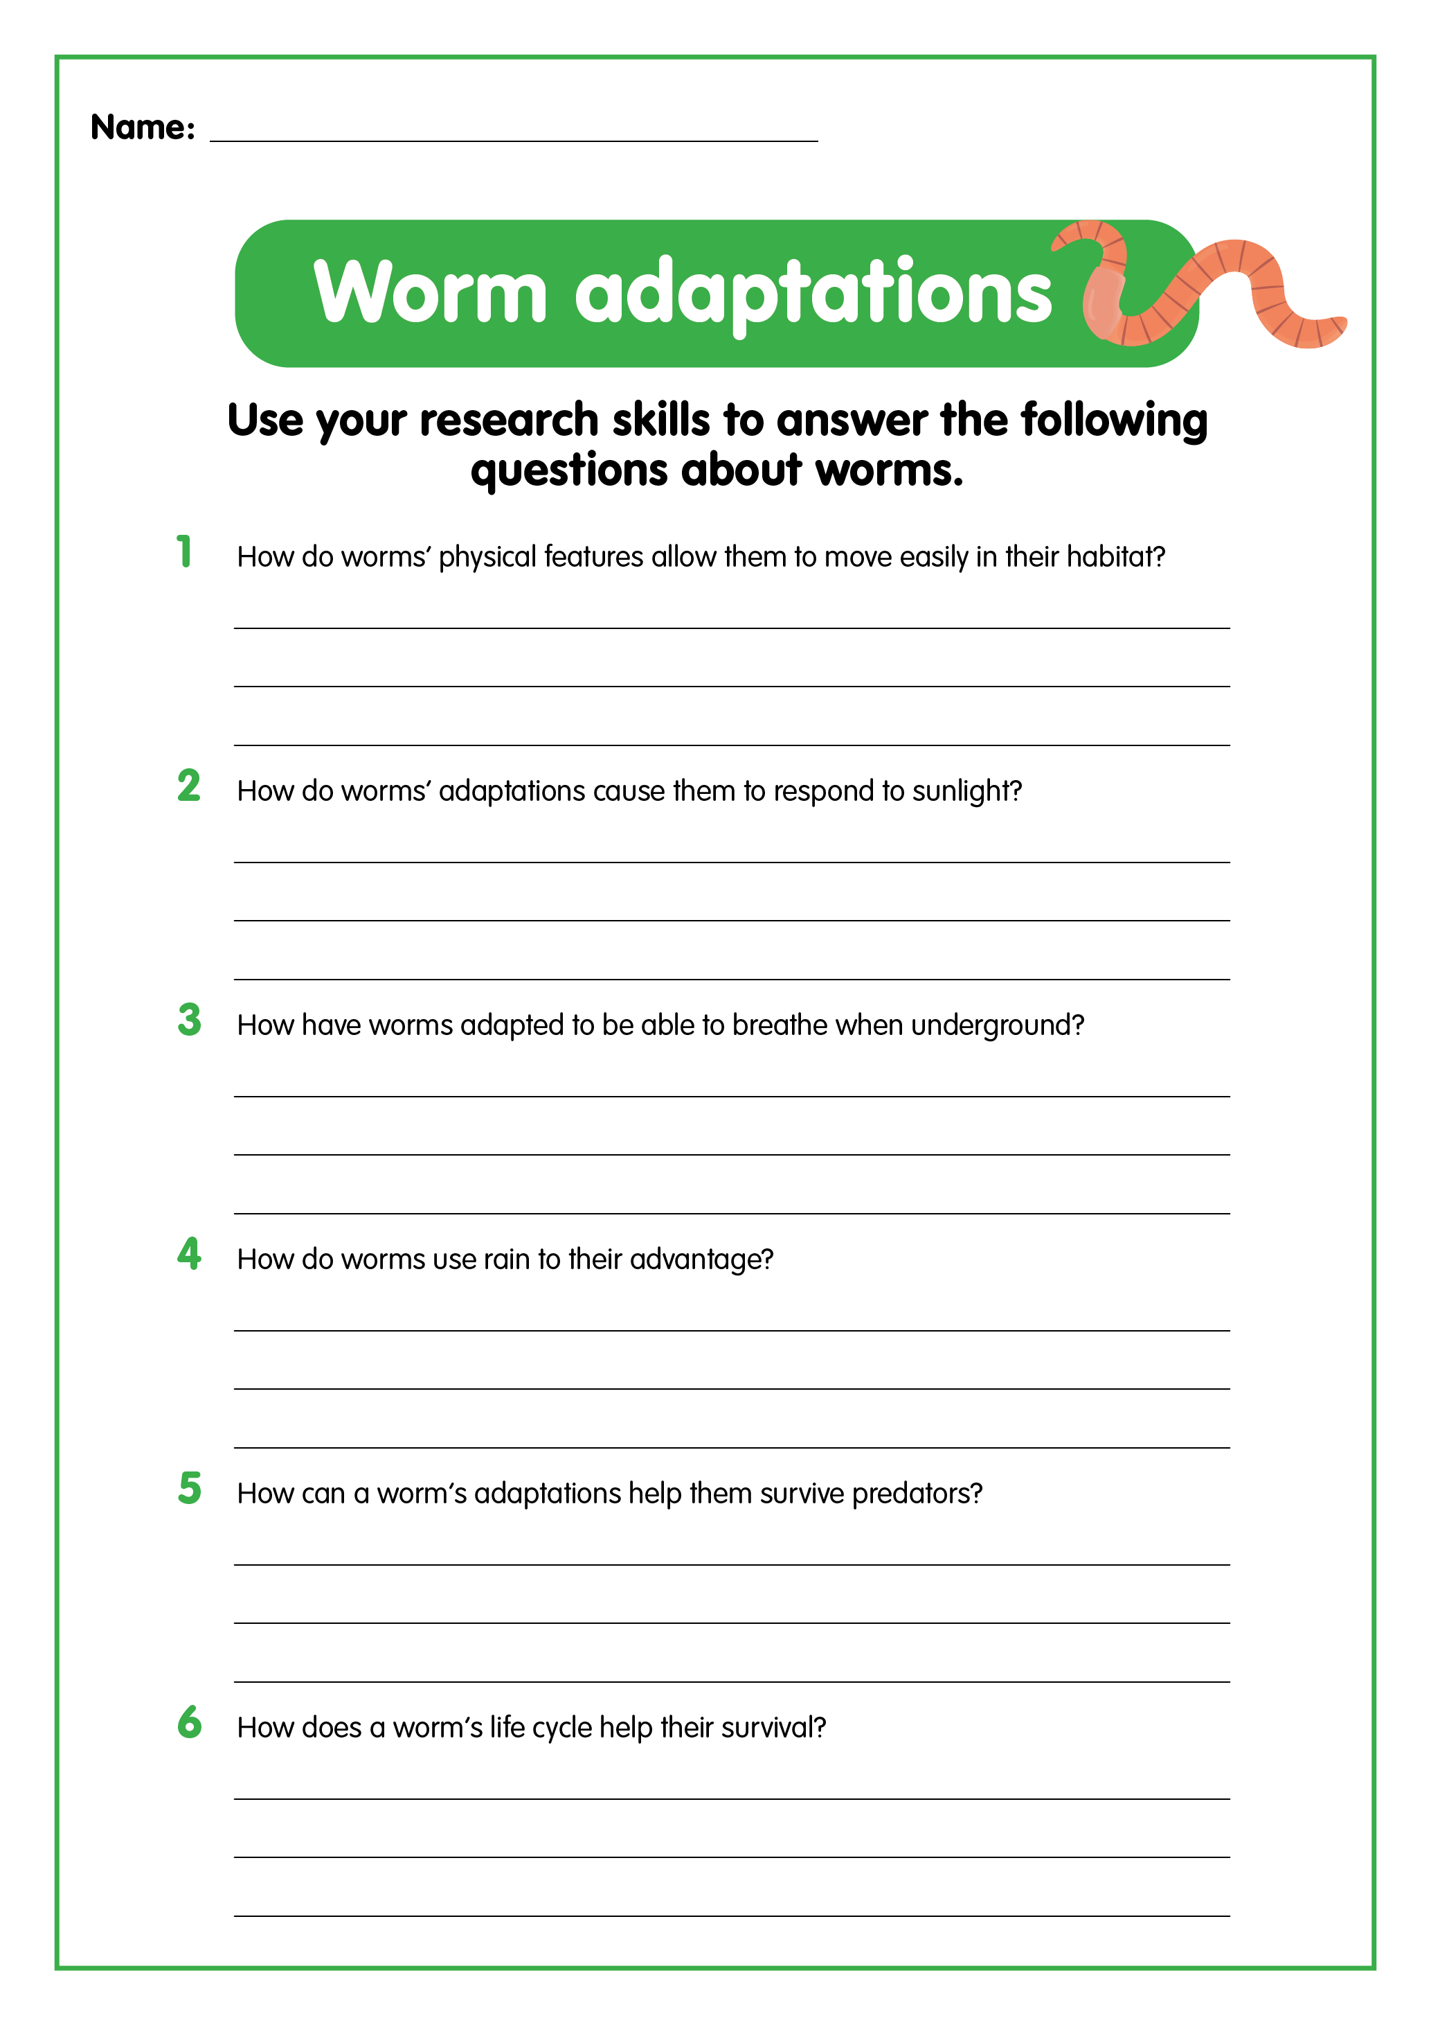
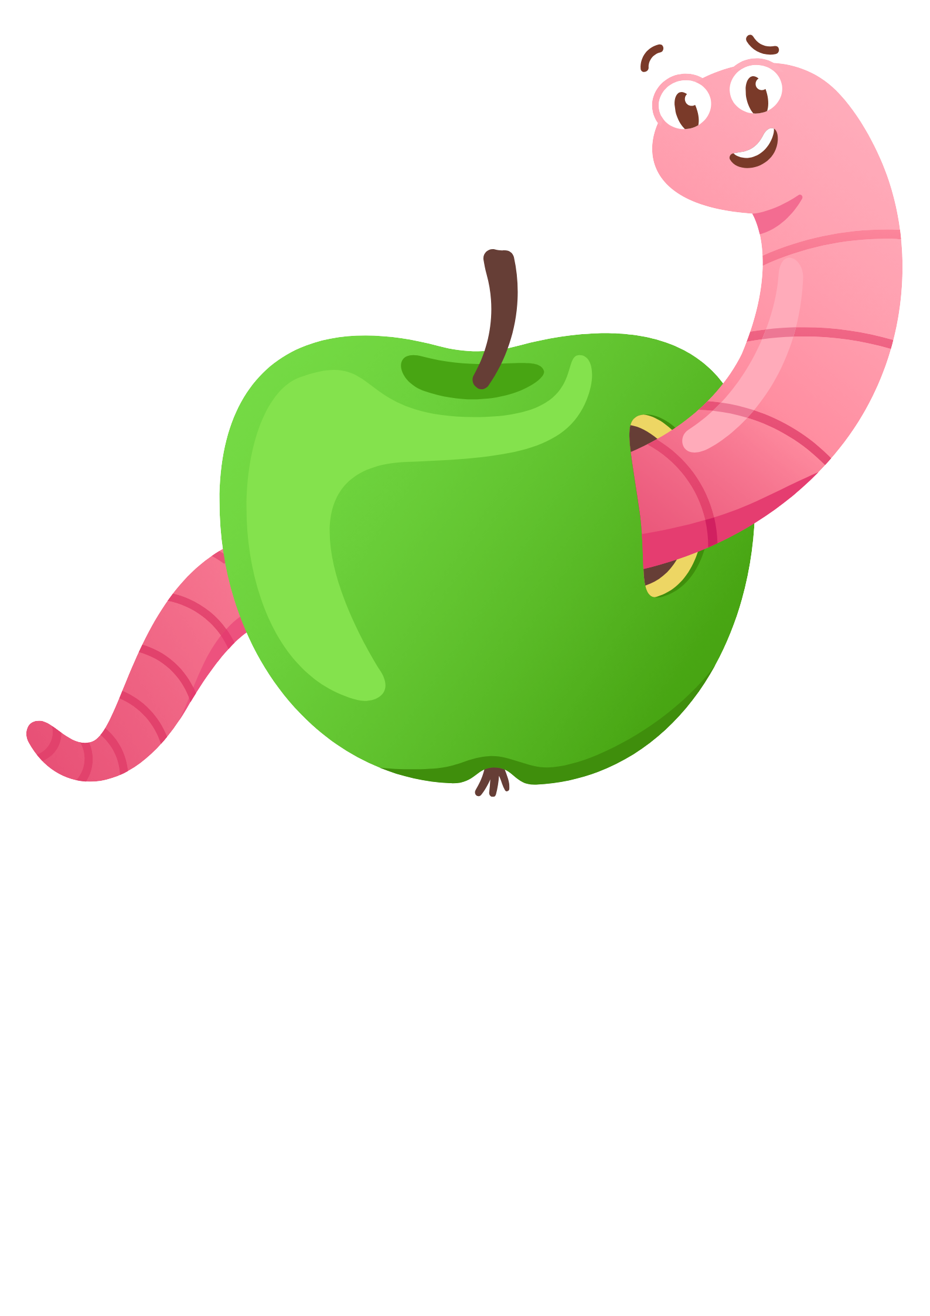
Let’s research
Research different websites to find information about worms and their adaptations. Use the QR codes provided.
Record your answers on the Worm adaptations worksheet.
Discuss your findings with a partner.

Slide 13

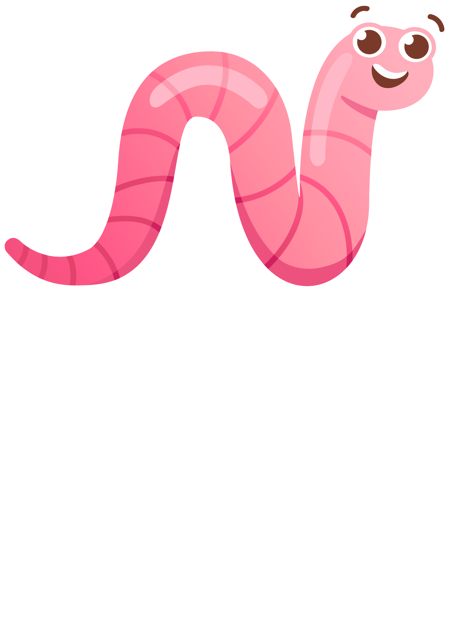
Let’s plan
You are going to design an experiment that will allow you to investigate how worms respond to an external environmental stimulus such as light, moisture, food or temperature. See the next slide for help designing the method for your experiment.
Decide which stimulus your experiment will examine.
Write your investigation question.
How do worms respond to ___________?
Design your experiment. Remember to include:
equipment and materials needed
procedure - steps to take to carry out the investigation
results and observations - a table to record observations and measurements

Slide 14

Example of external stimulus experiment method
How worms respond to light investigation method
Cover half of a tray with a thin layer of worm castings.
Place an exercise book (or piece of paper) over half of the tray to cover the castings.
Gently place about 10 worms on the side of the tray that is uncovered and give the worms some time to settle down. Use only 10 worms, because if there is more than that number, they will tend to bunch together rather than move around.
Make a prediction about how the worms will respond to the light and record your ideas.
Observe the worms for 15 to 20 minutes. During the investigation, carefully watch the worms to make sure they aren’t drying out. If this is the case, return them immediately to the worm farm.
Observe how the worms move.
Count and tally how many worms there are on each side of the tray every three to five minutes and record in a table.
Graph the results of your investigation (number of worms versus time).
Describe the pattern represented in the graph.

Slide 15
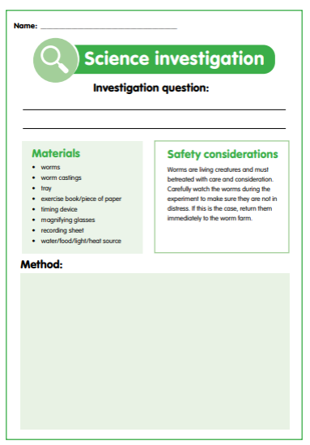
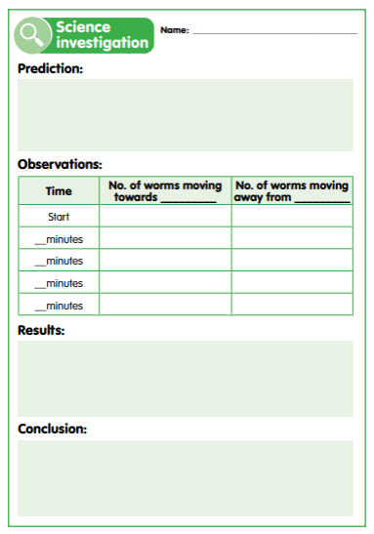
Let’s investigate
1. Carry out your experiment using the steps outlined in the method you created.
3. Analyse your findings to determine what the results show and how the worms responded.
2. Record your results and observations.
4. Draw a conclusion to answer your investigation question.
Making it digital
Record experiment procedure and results using an app of your choosing.
Take a photo or video of worms to show how they respond to the external environmental stimulus.
Use a voice record function to record your observations and conclusions.

Slide 16
Let’s discuss
How did your results compare with your prediction?
How did the worms respond to the external stimulus?
Why do you think the worms responded the way they did?
Did everyone get the same results?
Was your experiment fair and accurate?
How could you improve your experiment?

Slide 17
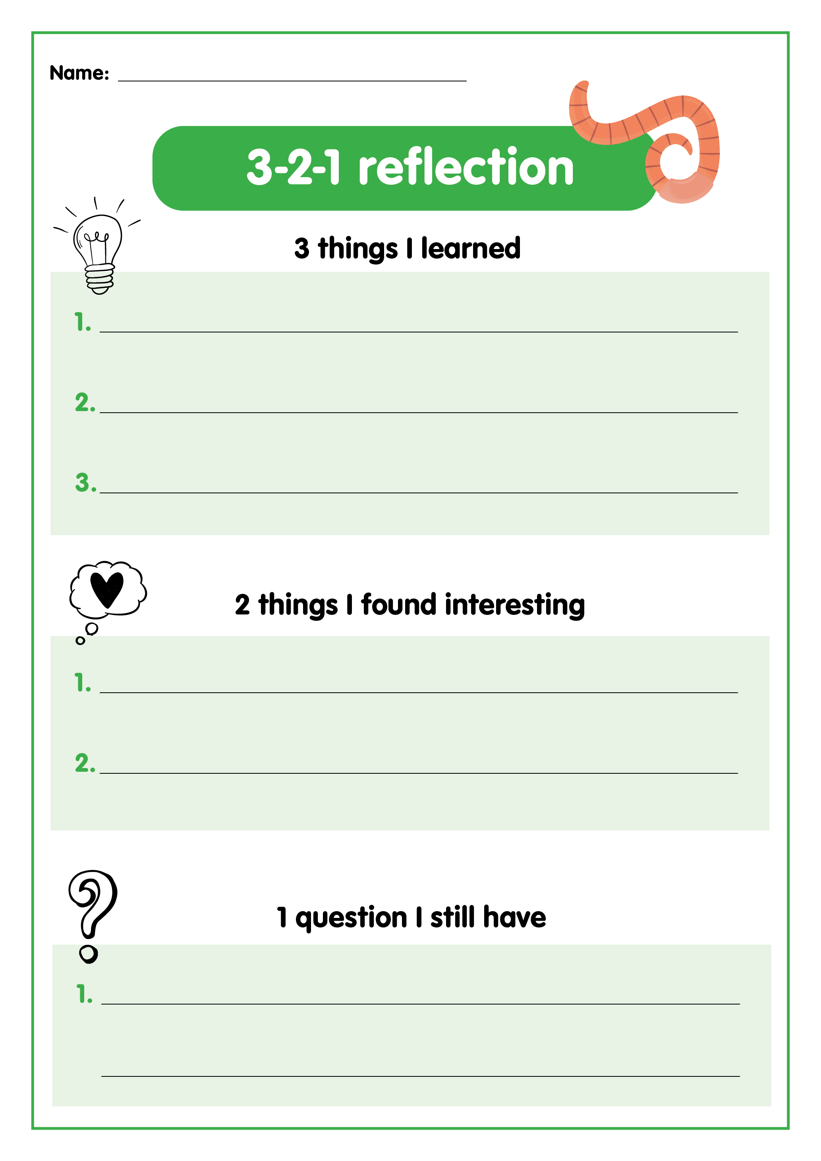
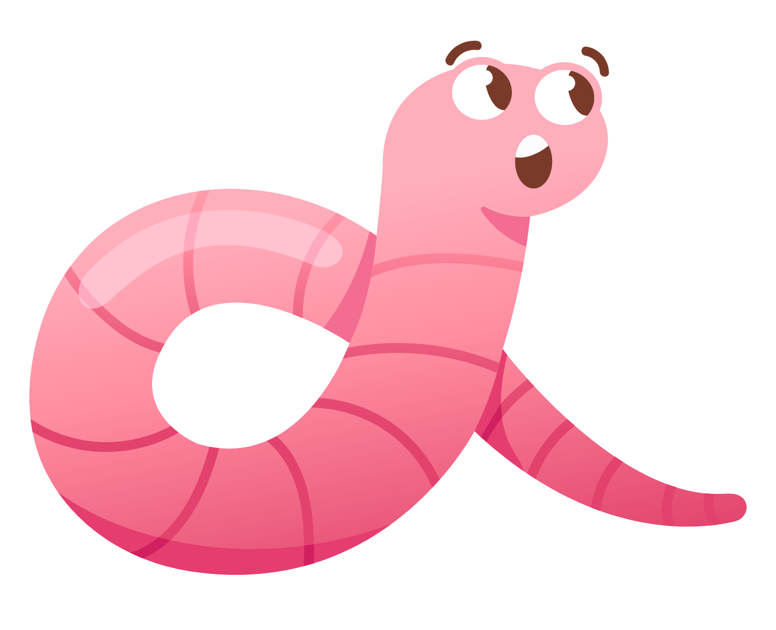
What have you learned about worms?

Slide 18
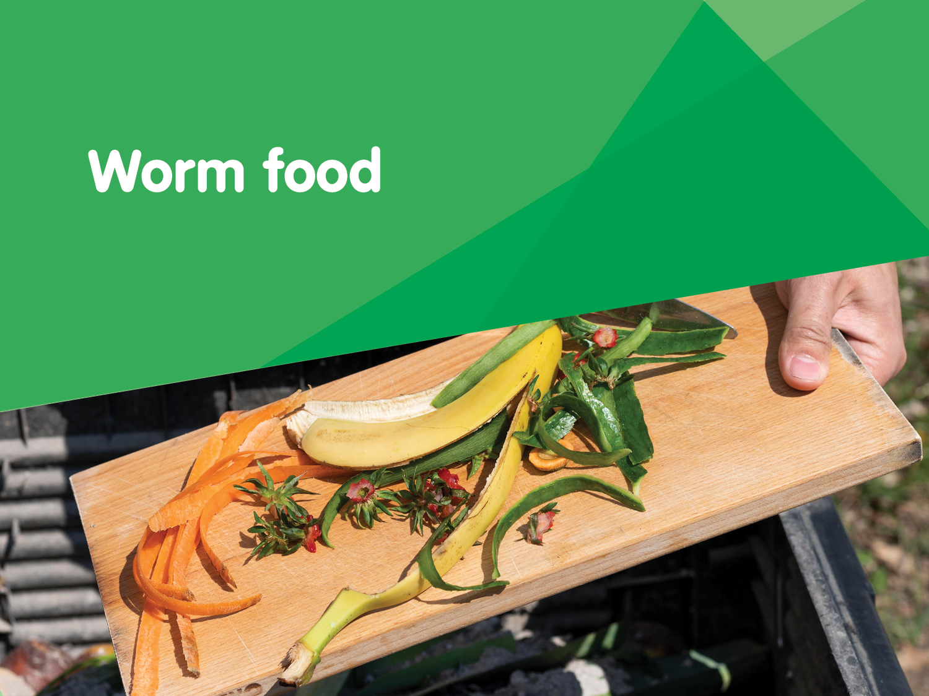

Slide 19
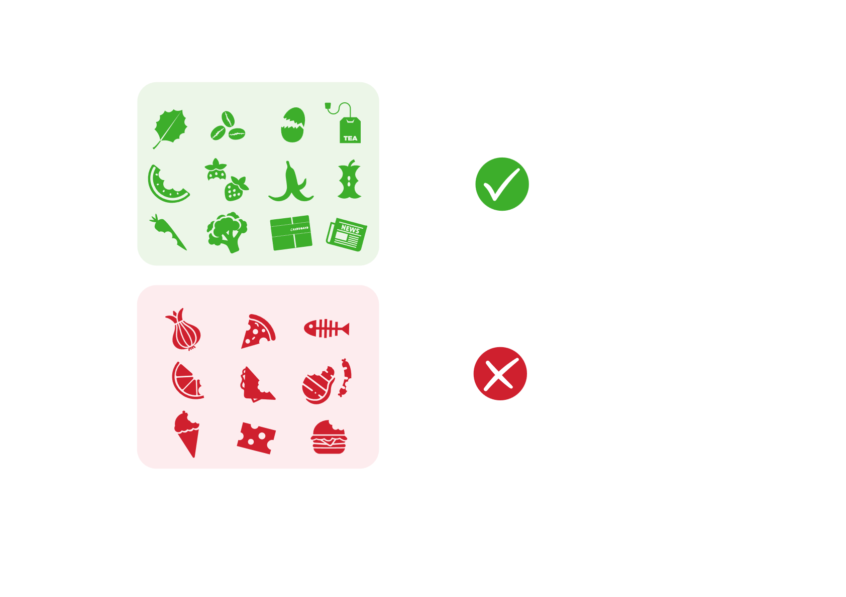
What do worms like to eat?
Composting worms can process anything organic.
They enjoy eating fruit and vegetable scraps, eggshells, tea and coffee grounds as well as shredded newspaper, straw or dry leaves.
Things to avoid in your worm farm:
  meat products
  dairy products
  white office paper
  bread
  citrus
  onions

Slide 20
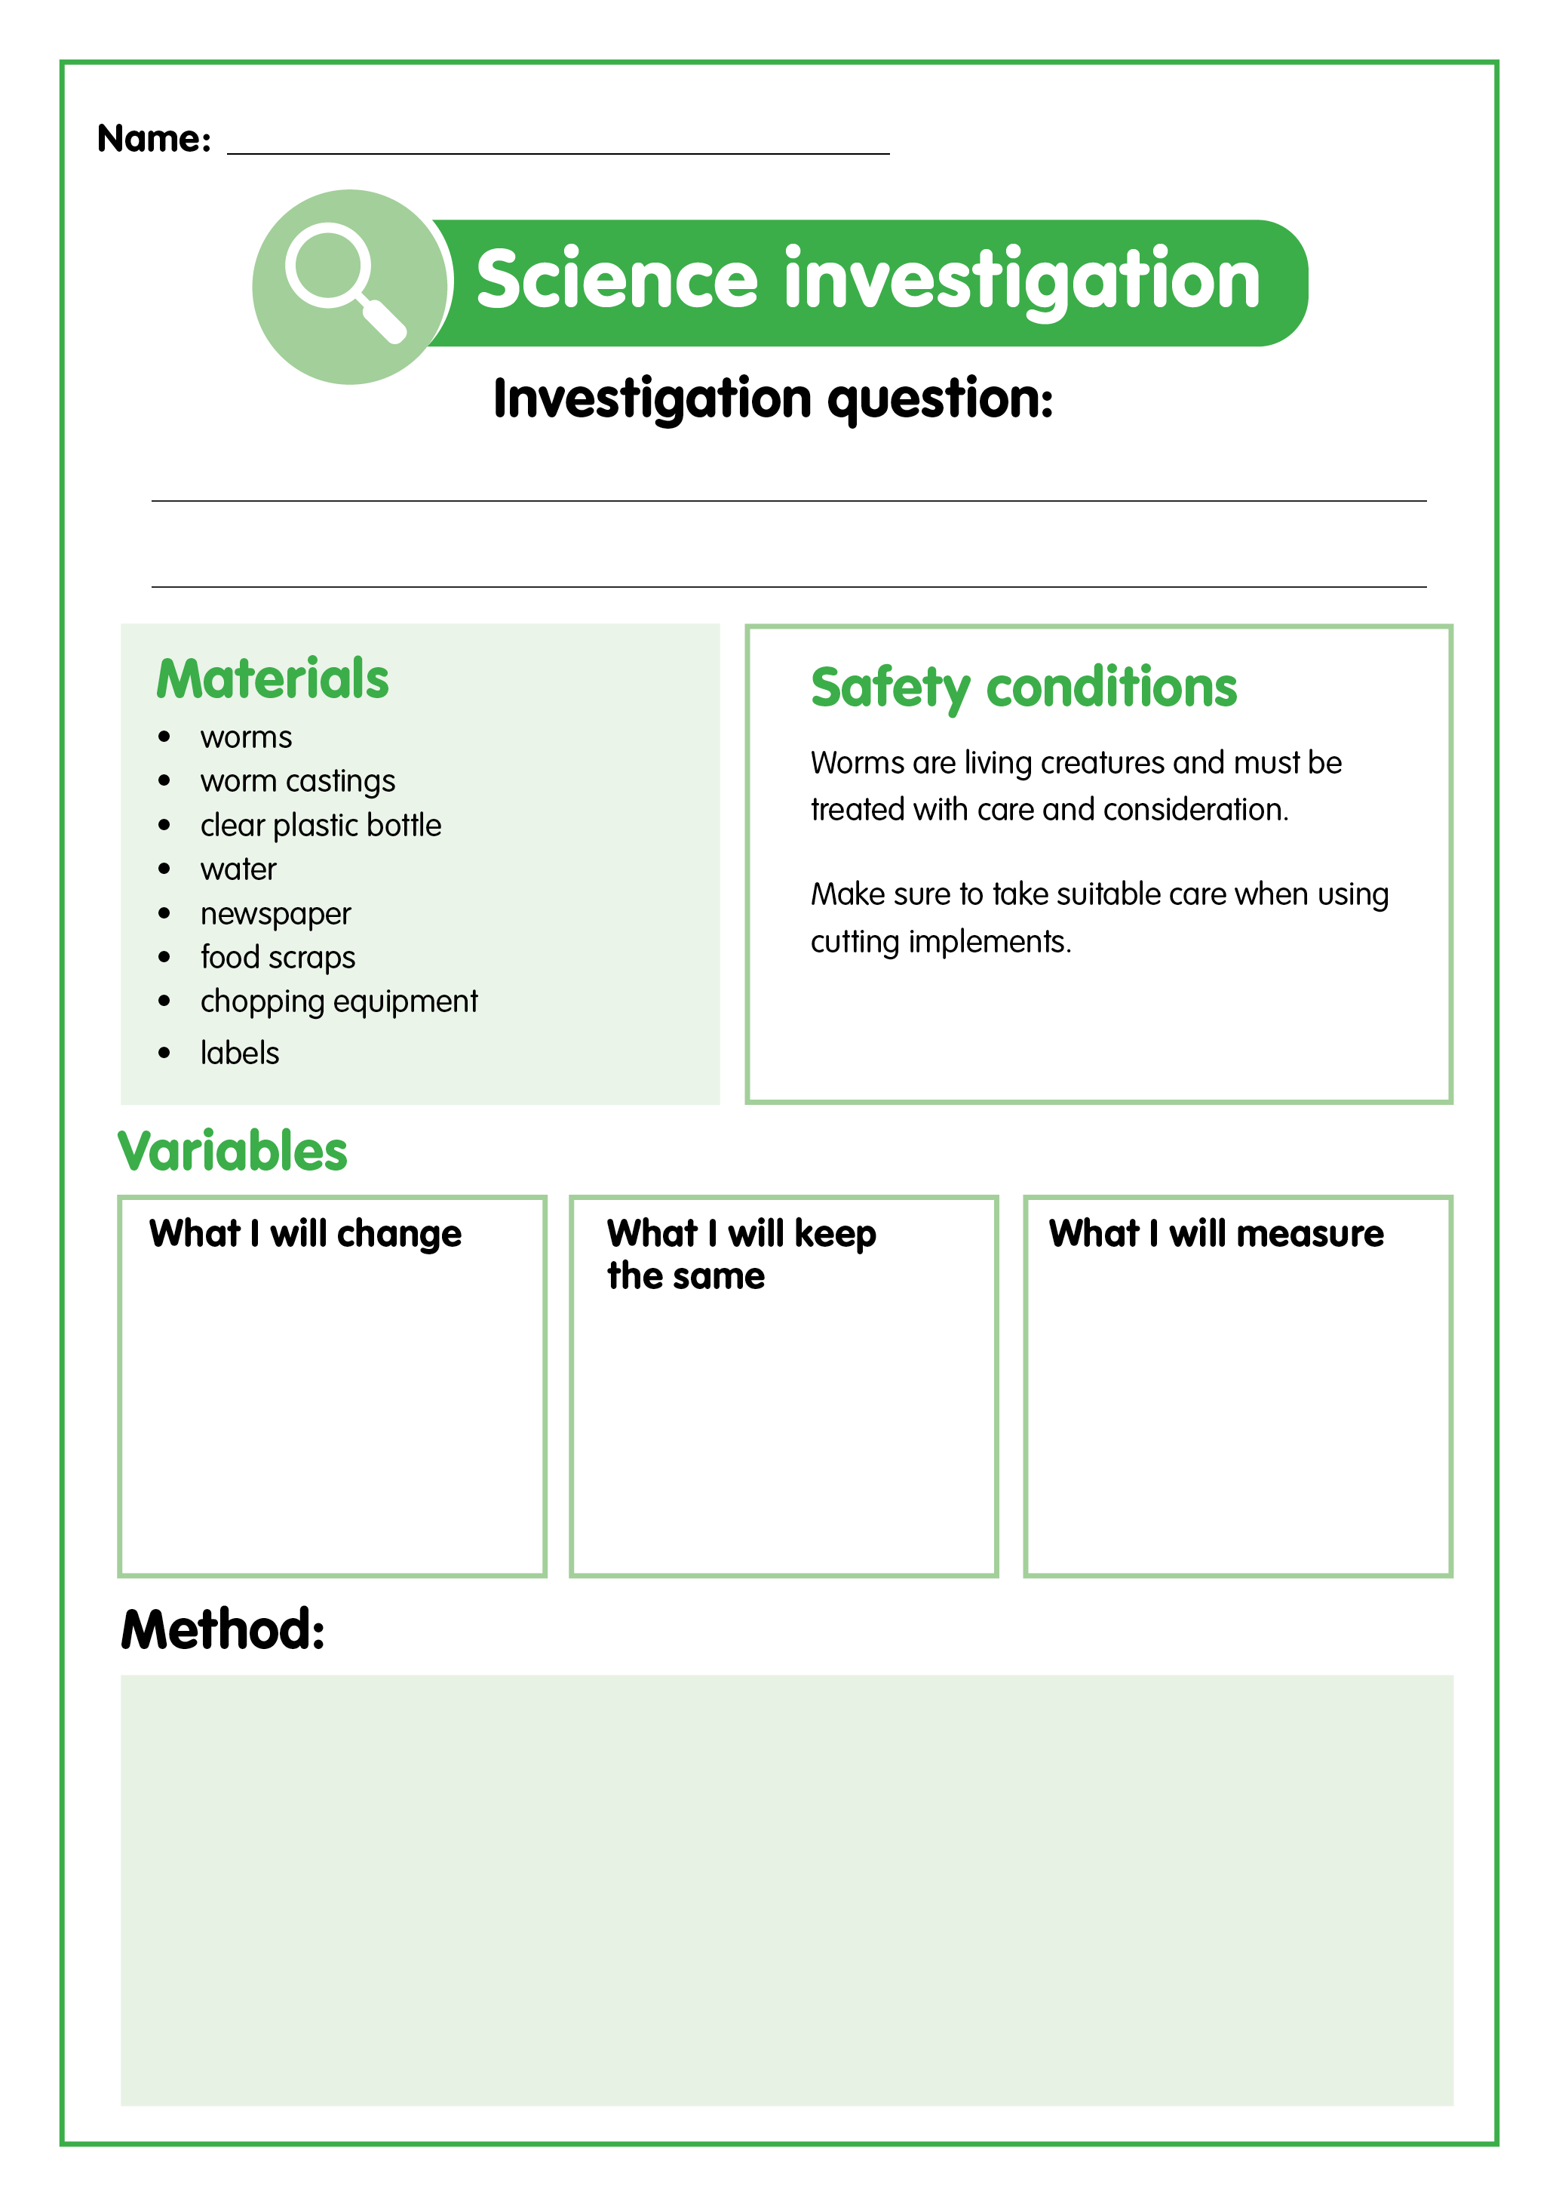
Let’s plan
You are going to design an experiment that will allow you to investigate how food should be prepared to optimise the amount of scraps that can be recycled in a worm farm.
Decide what type of food you will use for your experiment and how it will be prepared.
Let’s predict what we think will happen?
Write your investigation question.
Design your experiment. Remember to include:
method - steps to carry out the investigation
results and observations - a table to record observations and measurements.

Slide 21
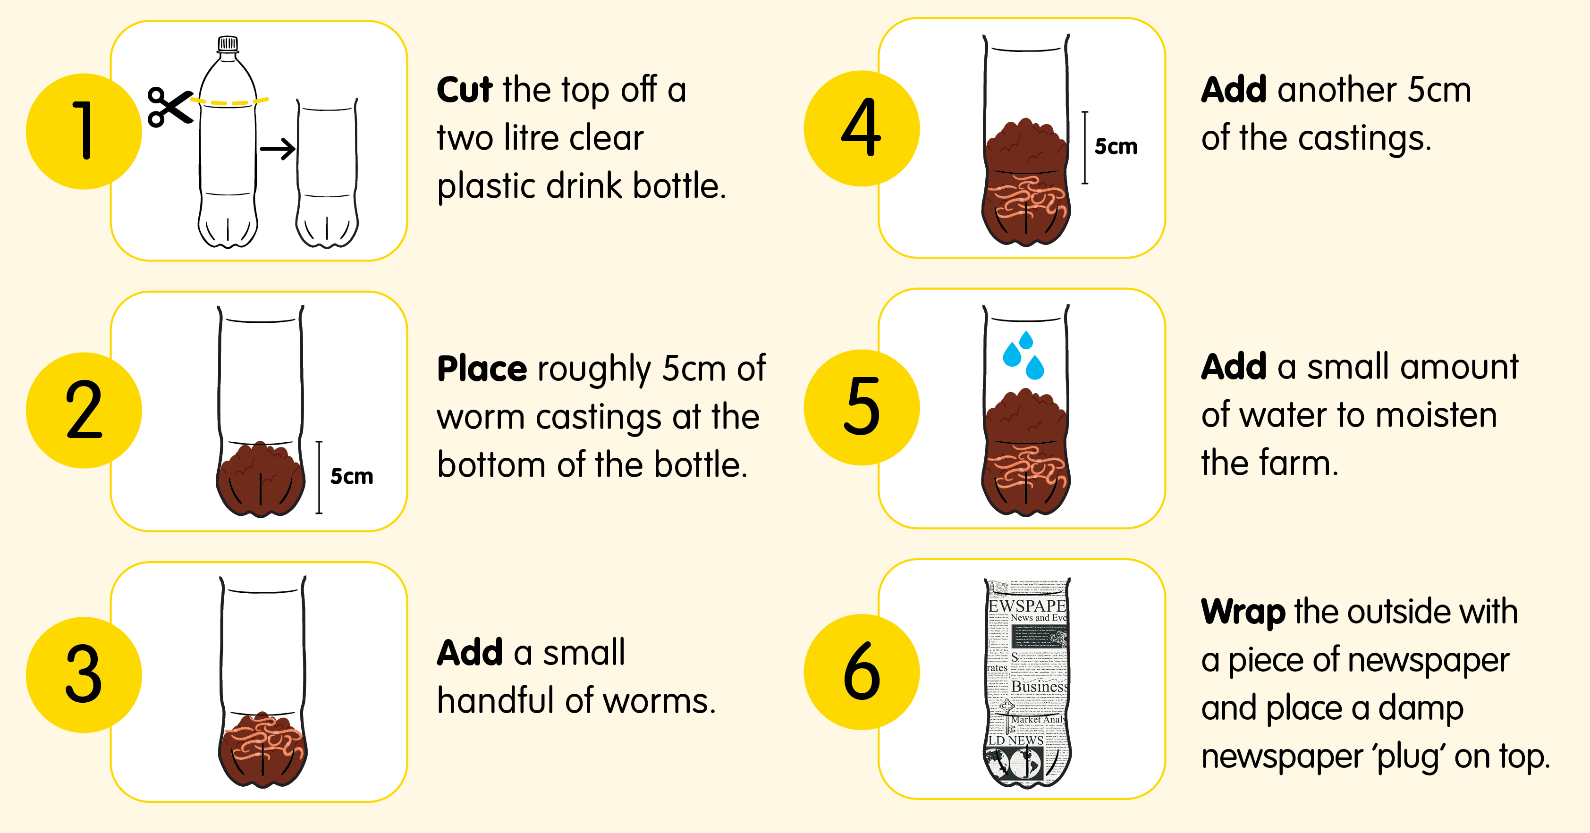
How to make a mini worm farm

Slide 22
Let’s investigate
1. Make your mini worm farm using the steps outlined in the infographic.
3. Add the prepared food to your mini worm farm. Make sure that you can see the food through the side of the bottle and that the food is completely covered with castings.
4. Cover and label your worm farm.
2. Prepare
your food scraps as per your experiment design.
5. Predict what you think will happen.
6. Check the worm farms every few days.

Slide 23

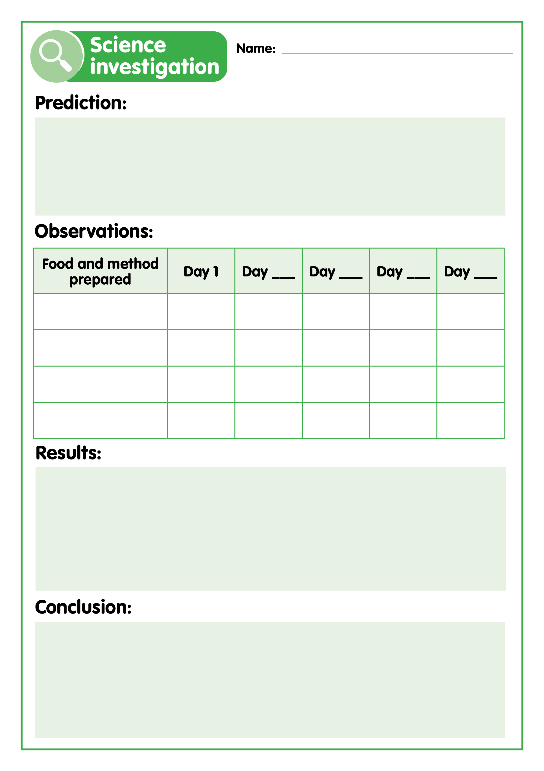
Let’s record
Record your observations until all the food scraps have been turned into castings.
Analyse your findings and compare with other groups to determine what the results show.
Draw a conclusion to answer your investigation question.
Discuss your findings and conclusion.
Making it digital
Use a digital device to take photos of the food in the worm farm each week.
Import the photos into an app of your choosing and label them with the date they were taken to create a visual timeline of the food being turned into castings.

Slide 24
Let’s discuss
Which food preparation style was eaten the quickest?
Which food preparation style was eaten the slowest?
Did your findings match your predictions? Why/why not?
Can you think of a reason that your findings did not match your predictions?
Was your experiment design fair? Why/why not?
Did you notice any patterns when you compared your data with other groups?
Why is a worm farm a suitable place for worms to live?

Slide 25
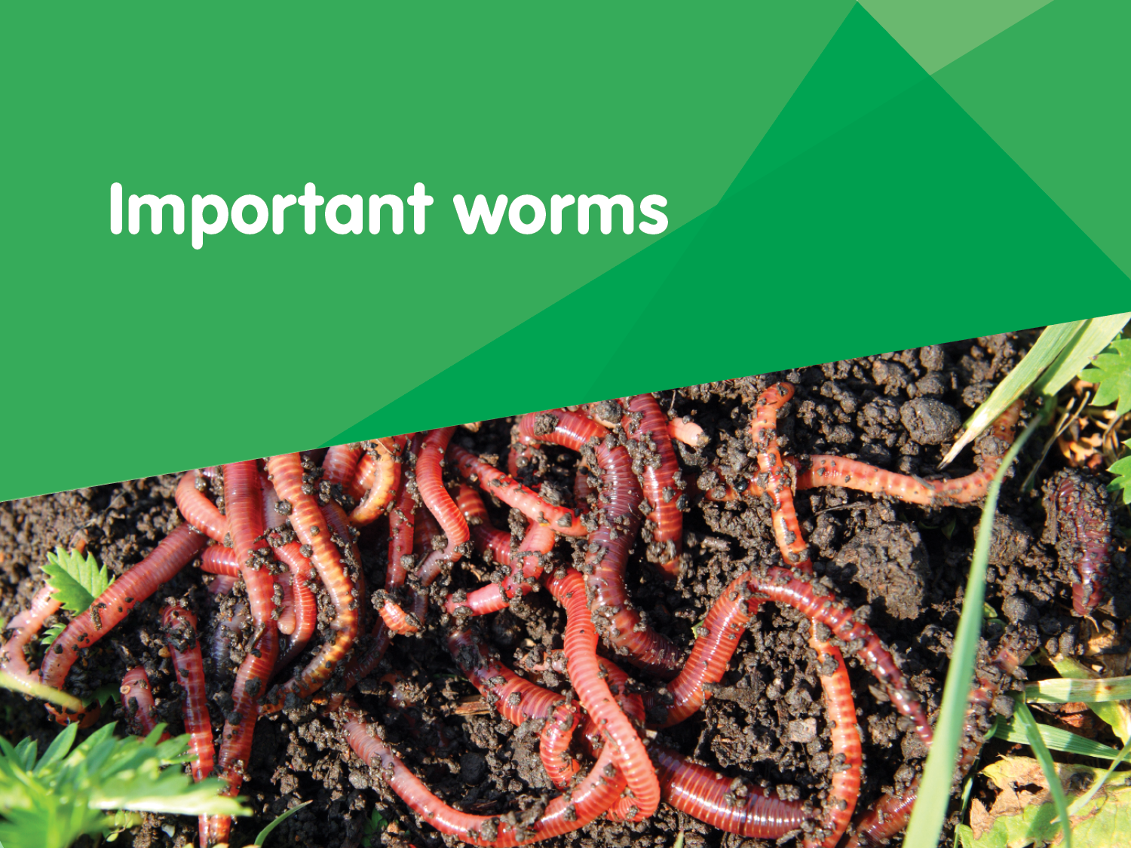

Slide 26

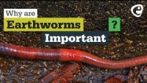
Let’s discuss
Let’s watch the video to find out why worms are so important.
Discussion questions
How big can some species of worm grow?
How many different species of worm are there worldwide?
How many groups of worm species are there?
What do worms eat?
How many times more nutrients does soil that has passed through a worm have?
Why is it good when worms break soil apart?
Why are earthworms important? - YouTube

Slide 27
Why worms are important
Worms make tunnels when they move through the soil. These tunnels make it easier for plant roots to absorb the oxygen and water they need to grow.
Worm waste provides food for plants. Worm poo is called castings and worm wee is called leachate. These both add nutrients to the soil.
Worms eat lots of organic waste, things like old plants, fallen leaves and food scraps.
They improve and build soil by improving its physical structure, enriching it with micro-organisms and improving water-holding capacity.
They increase crop yield by helping with germination, improving root growth and structure, and feeding growing plants.

Slide 28
Why worm farms are important
Worm farms decrease the amount of organic waste that is sent to landfill.
They close the recycling loop. Our organic waste is changed into organic fertiliser that plants use and produce food for us to eat.

Slide 29
Let’s plan
You are going to design an experiment that will allow you to investigate the impact of worm castings and leachate on plant growth.
Decide which variables your experiment will examine.
There are four variables that can be tested in this experiment:
Write your investigation question.
How is grass growth affected by _________________?
Soil and water
Soil and leachate
Design your experiment. Remember to include:
what you will change, keep the same and measure
method - steps to carry out the investigation
results and observations - a table to record observations and measurements
50/50 mix and water
50/50 mix and leachate

Slide 30
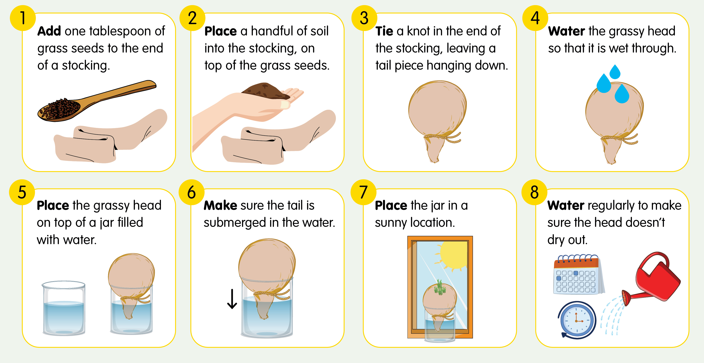
How to make a grassy head

Slide 31
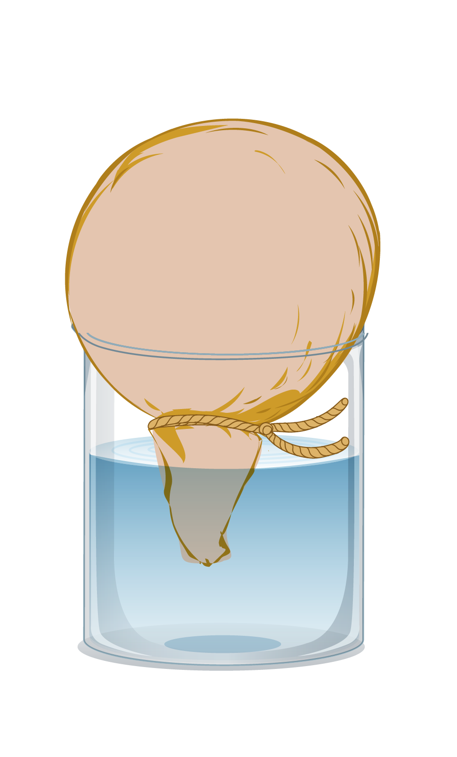
Let’s investigate
1. Make your grassy heads following the instructions on the infographic.
4. The beneficial microbes in worm leachate can be harmed by light, so wrap the jar with newspaper if using.
2. Keep your constants and variables consistent to ensure accurate results.
5. Check the grassy heads regularly and record your observations.
3. Clearly label each head with the variables being tested.
Consider:
What is the most effective way to collect data from this investigation?
What results can we measure?
How often should we measure?
Let’s predict what we think will happen?

Slide 32
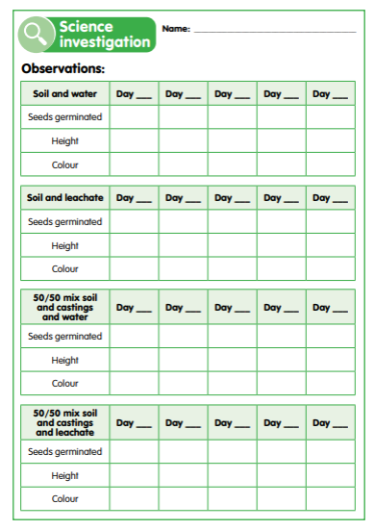
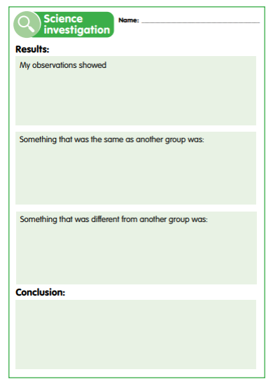
Let’s record
Record the height and colour of the grass at regular intervals as it grows.
Draw a conclusion to answer your investigation question.
Create a scientific report of your findings, including your table, graphs and conclusions.
Discuss your findings and conclusion.
Analyse your findings and compare with other groups to determine what the results show. Find the similarities and differences.
Making it digital
Use a digital device to take photos of the changes to the grassy heads and use these to create a visual record of any changes.
Record your measurements and observations digitally through text, audio or video.
Combine these elements to complete a digital scientific report.

Slide 33
Let’s discuss
Which stocking head grew ‘hair’ the fastest? Why do you think this is?
Did your findings match your predictions? Why/why not?
What does this tell us about the effect of worm leachate and castings on plants?
Do you think this was a fair experiment to test the effect of worm leachate and castings on plant growth?
How could you improve your experiment?
Why are worms beneficial to have in a garden?
What could we do with worm leachate and castings at school?
If you had your own garden, would you use worm leachate or castings on it? Why?

Slide 34
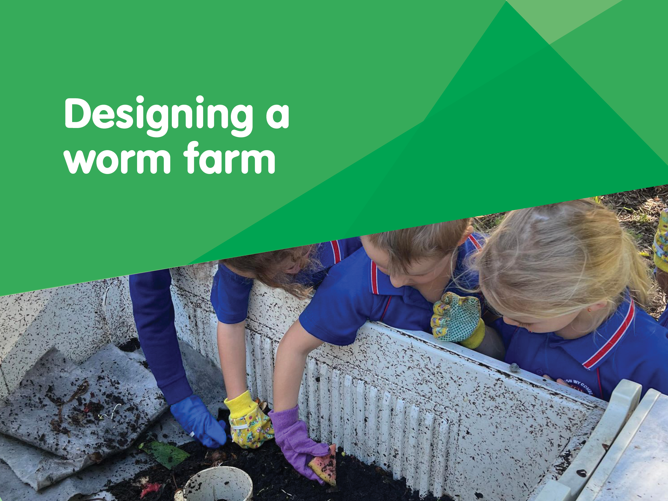

Slide 35
Let’s research
What do worms need to survive?
How many worms will we need?
What are the benefits of a worm farm?
Worm
farm designs
  What features and adaptations do worms have and how does this relate to what they need to survive in a worm farm?
  Where would be the best place to locate a worm farm?
  What can worms eat?
How much food waste do we produce at school each day?
How much food can worms eat in a day?
How many worms will we need to process our waste?
How would a worm farm impact the amount of waste going to landfill?
Could it save the school money on waste disposal?
How could we profit from a worm farm?
What recycled materials can a worm farm be made from?
What features does a worm farm need to have?
How can the leachate be collected?

Slide 36
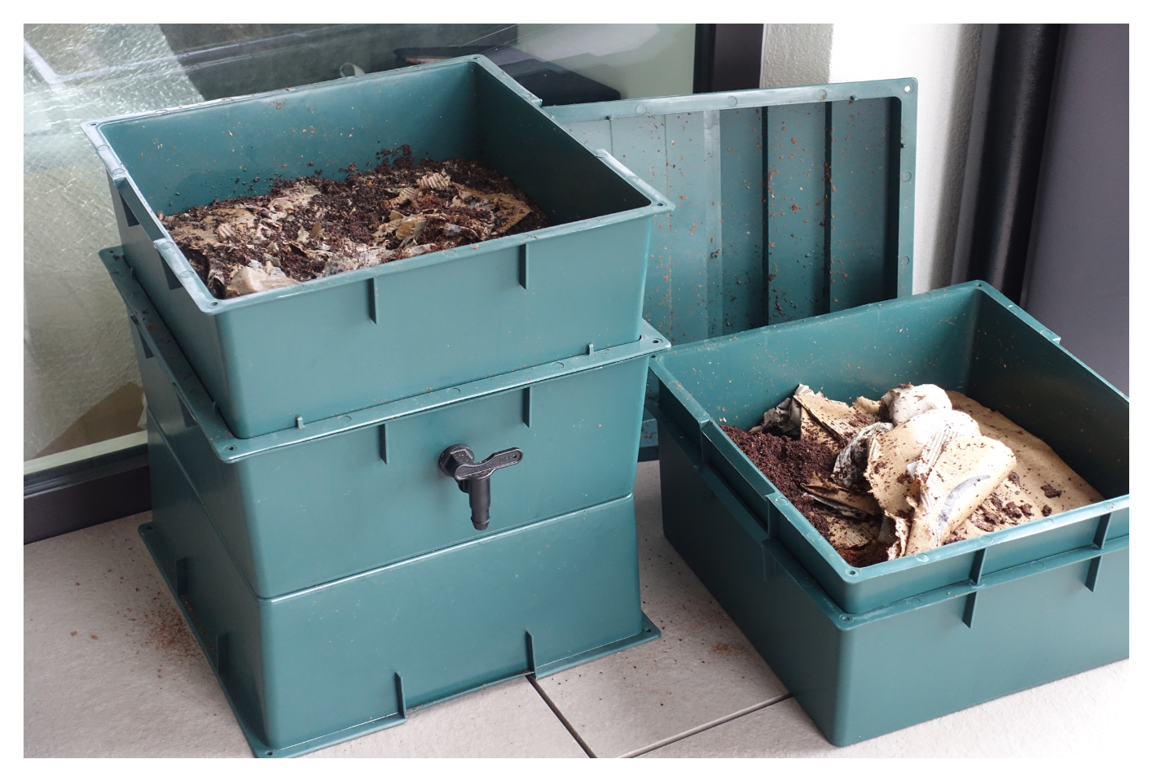
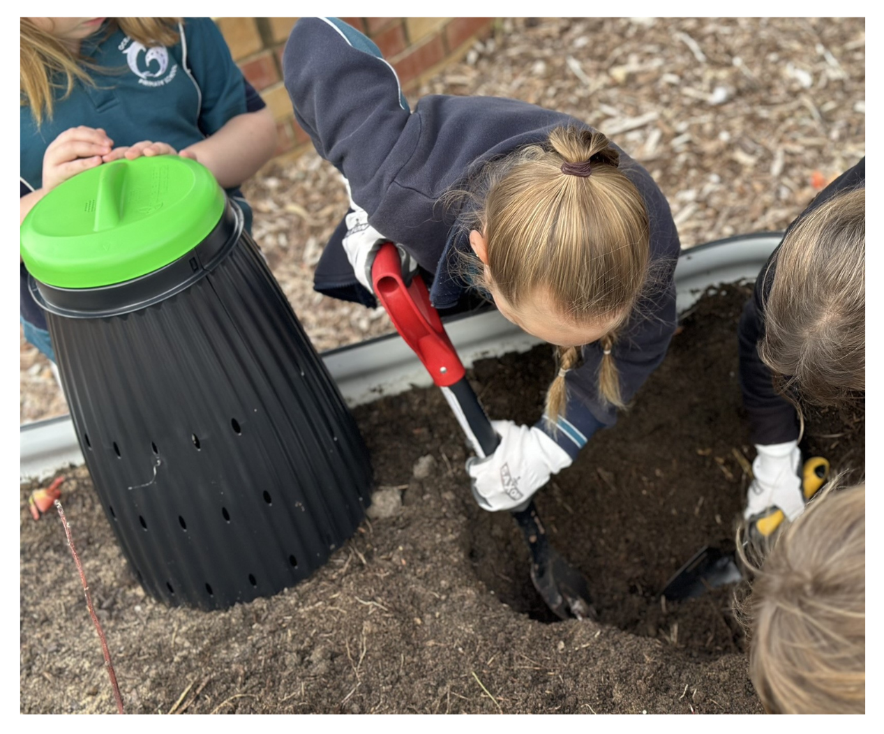
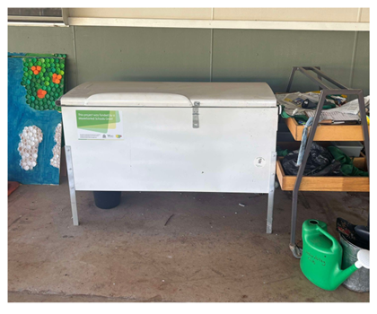
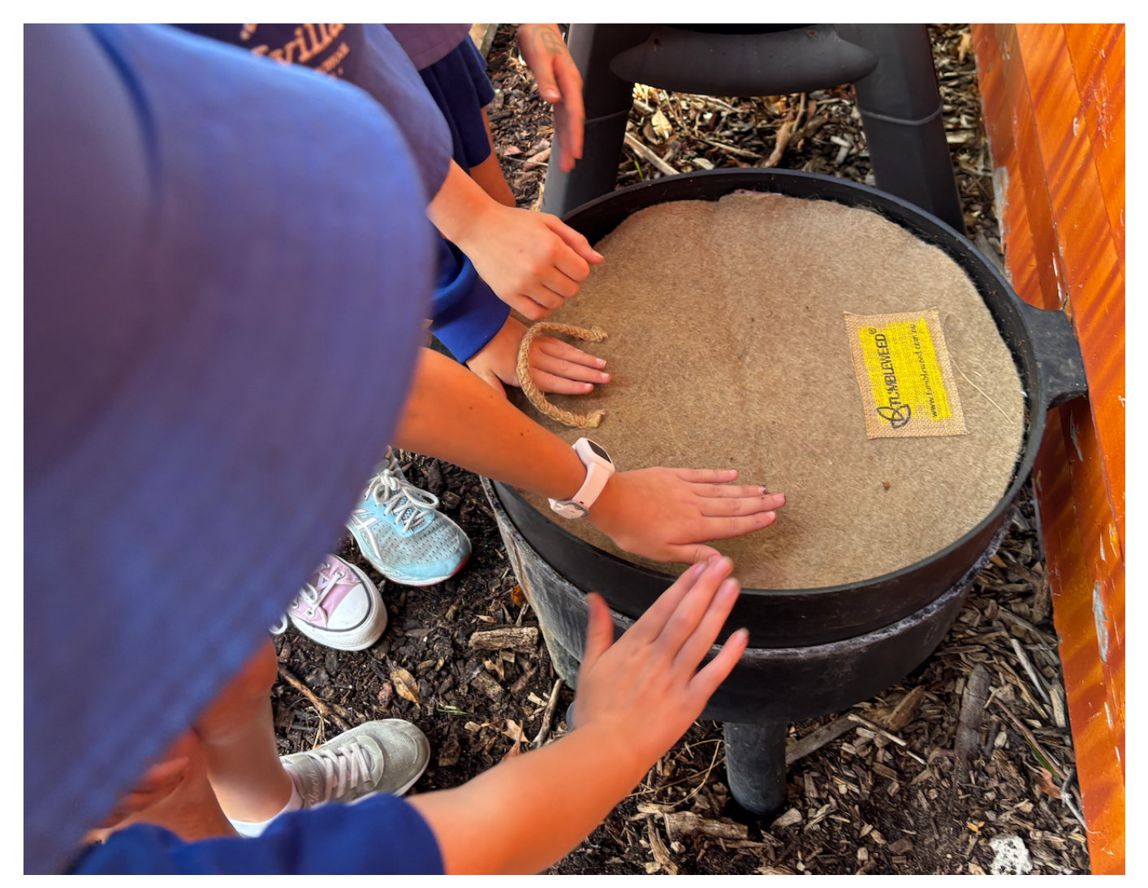
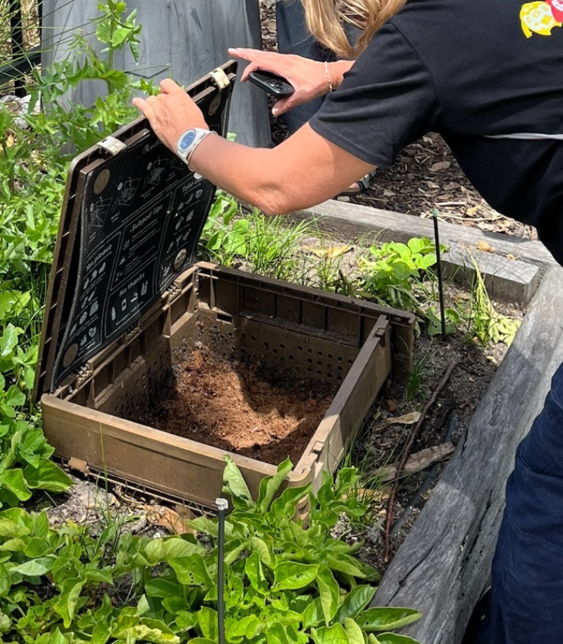
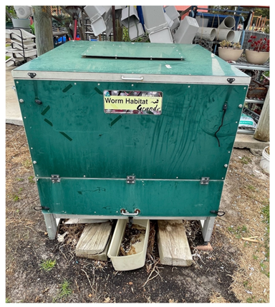
Design ideas
Stackable, layered design
Inground
design
Repurposed items

Slide 37
Let’s plan
Design
What container will you use for your design?
What additional materials will you need?
What bedding will you use?
How will the leachate be collected and stored?
Calculate
How much organic waste does the school produce each day?
How big will the worm farm need to be?
How many worms will need to be added to the worm farm to begin with?
What does it cost the school to dispose of waste?
How much could we save by setting up a worm farm?
Locate
Where is the best location for the worm farm?
Draw a detailed map to represent its position on the school grounds
Plan ahead
What will happen to the organic waste that cannot go in the worm farm?
What will be done with the leachate and castings that are produced?

Slide 38

Let’s create
Using the research and planning you have completed, create a presentation about your worm farm design.
Your presentation must include:
Worm farm design, including size and measurements
Location map of the worm farm
Calculations relating to food waste produced,
worm numbers and waste disposal costs
Plan for leachate collection and storage
Making it digital
Use an app of your choosing to create a digital presentation that can include text, audio, photos and videos.

Slide 39
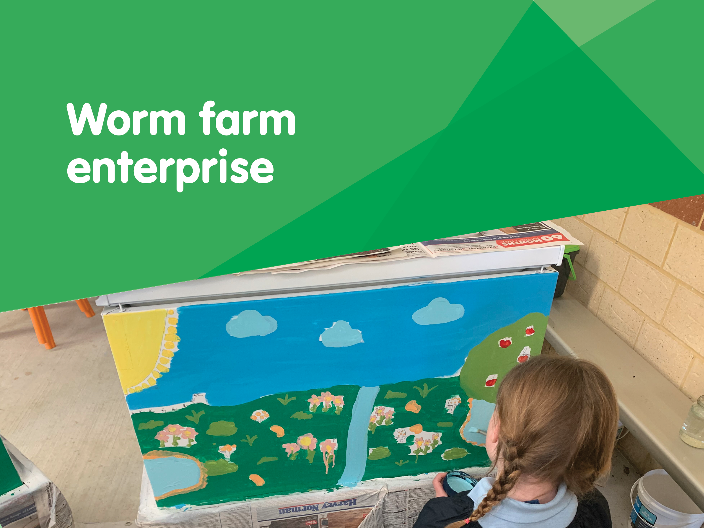

Slide 40
Let’s research
What products from the worm farm can we sell?
How can we advertise our product?
What type of packaging should we use?
What products does the worm farm produce?
How much does it produce?
How difficult is it to harvest?
What should our labelling look like?
How will we let people know about our product?
What will the packaging be made from?
Does it need to be waterproof or airtight?
Does it need a lid/tie?
Where will we source the packaging from?

Slide 41
Let’s research
What purchasing decisions do
we need to consider?
What are the costs involved?
What are the benefits for the school?
What factors affect people's purchasing decisions?
How much will people be willing to pay for your product?
How will we encourage people to buy our product?
Are there any costs related to setting up your business?
Are there any costs related to running your business?
Will your business earn revenue?
How can the leachate and castings be used at school?
How can it be used to raise funds for the school?

Slide 42
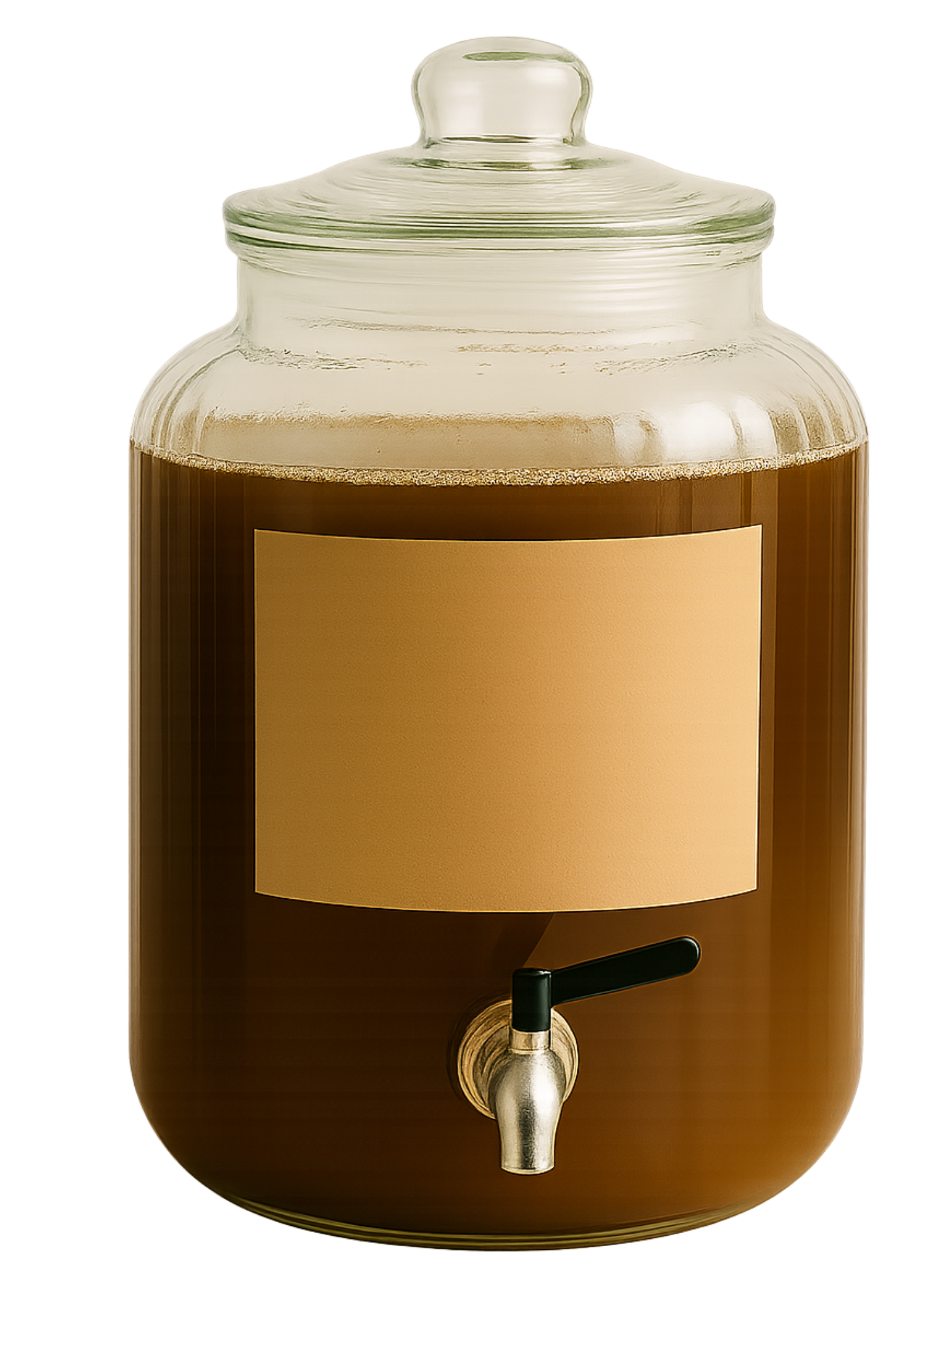
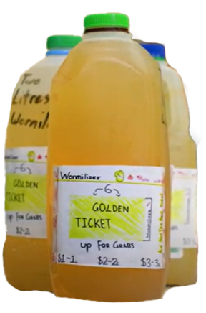
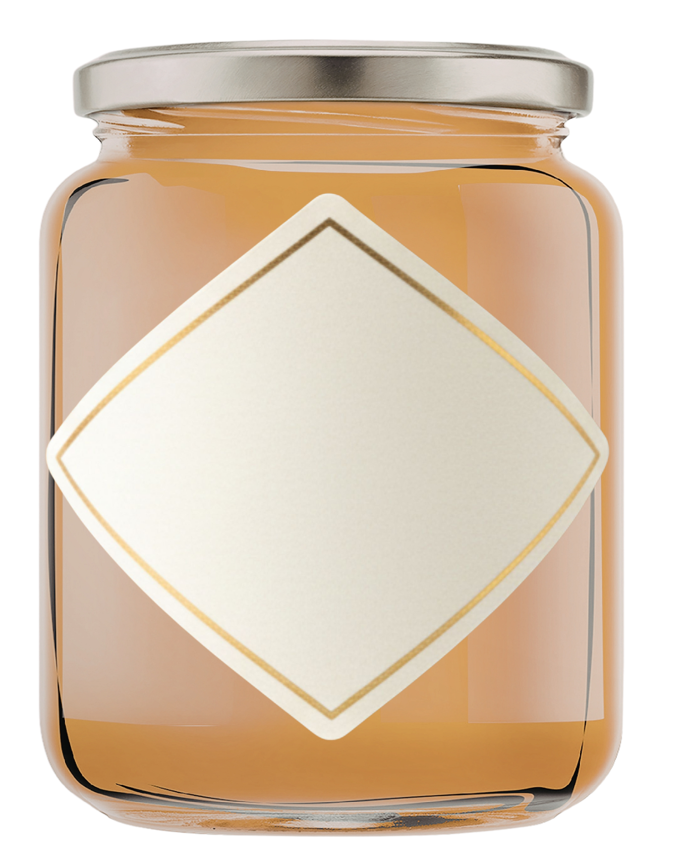
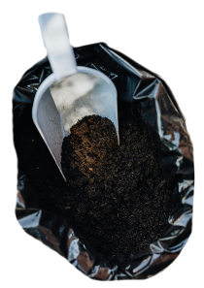
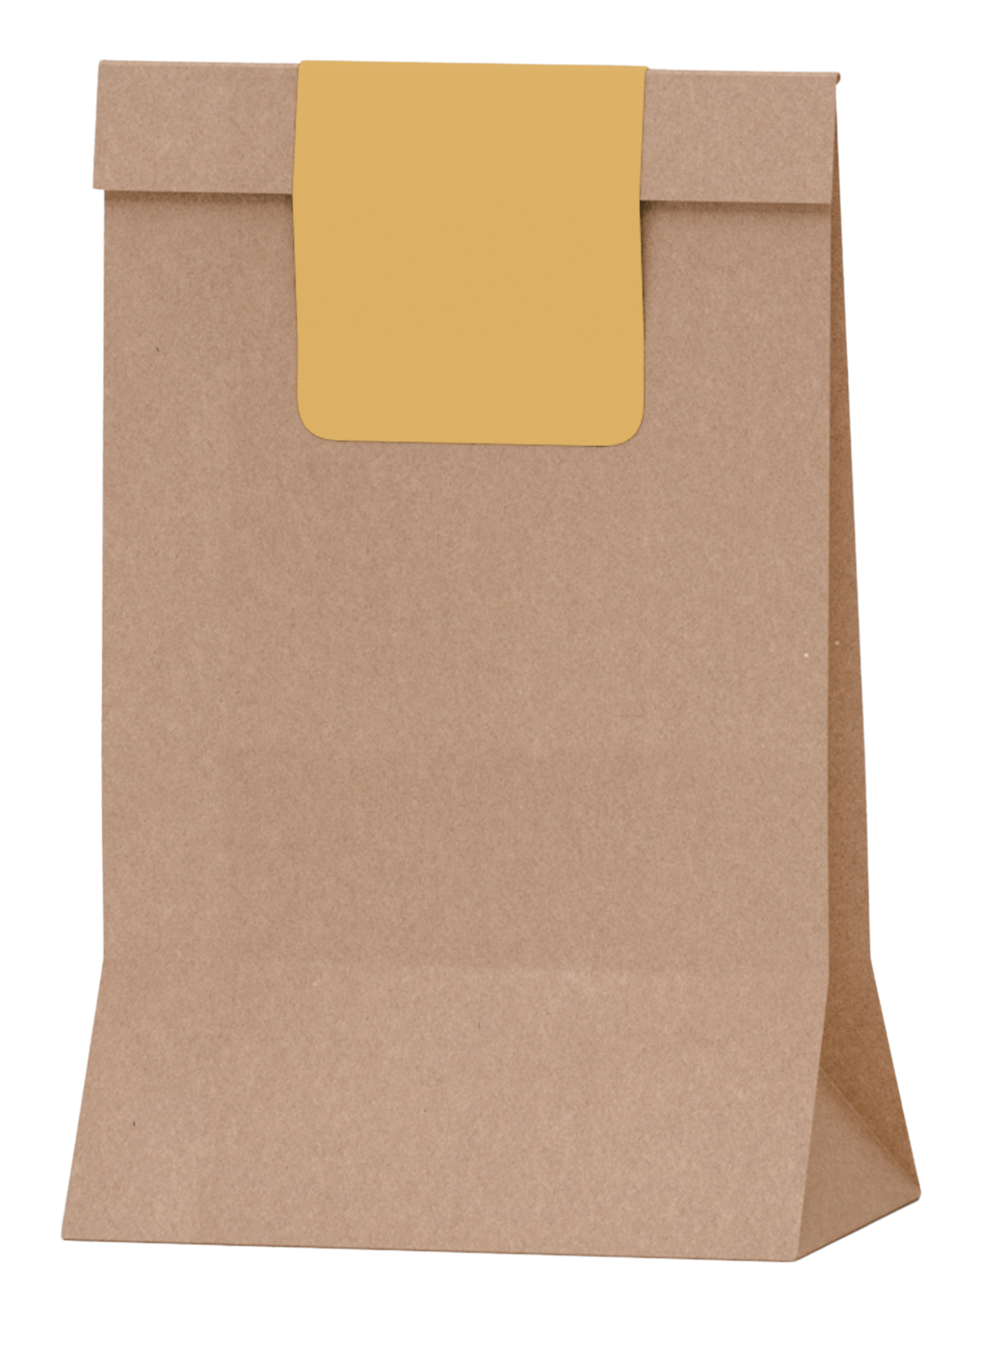
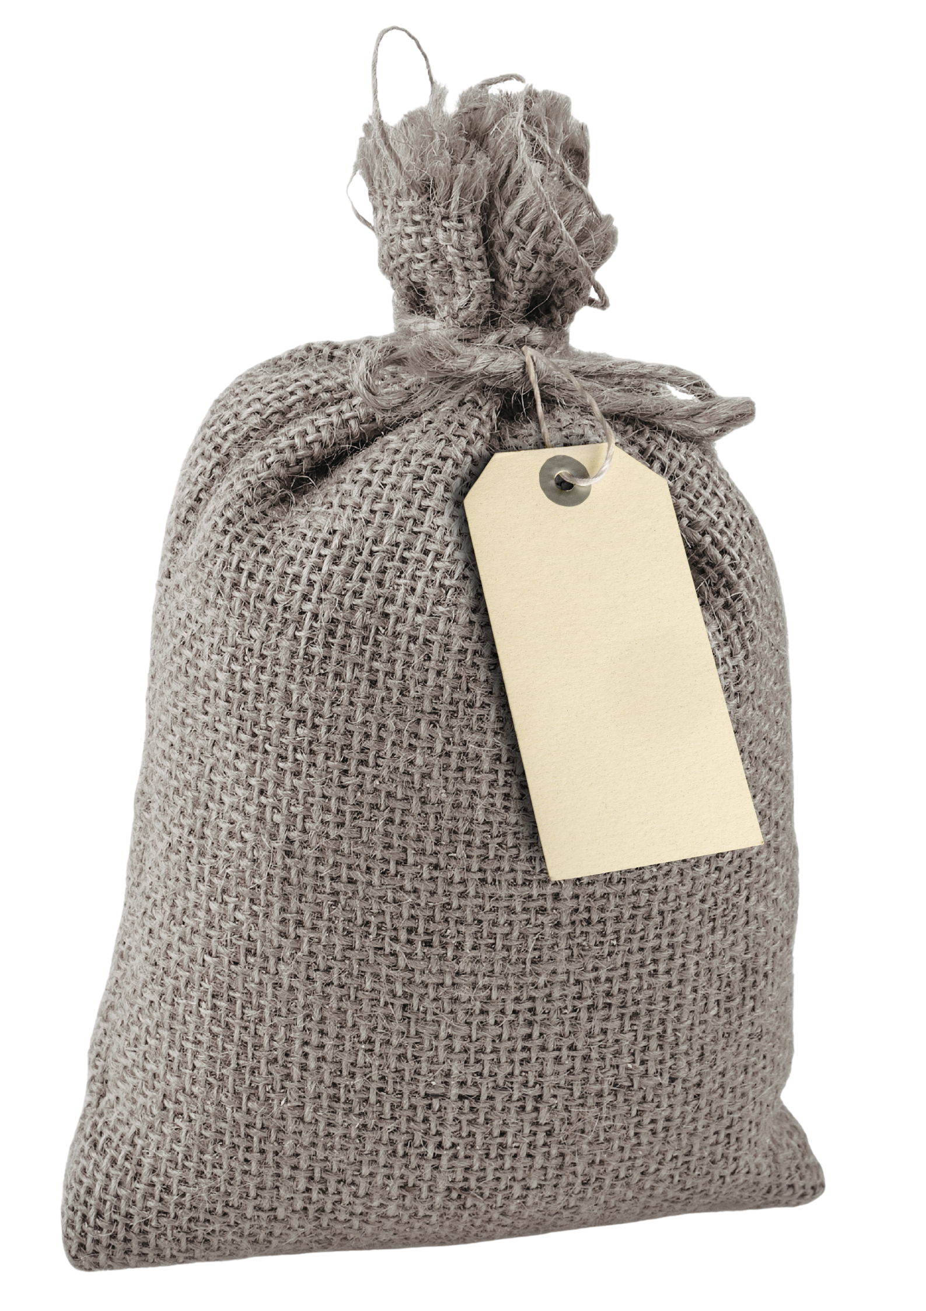
Design ideas

Slide 43
Let’s plan
Design
What product will you sell?
What will your product be called?
What packaging will you use?
What will your label look like?
Calculate
Are there any costs related to setting up and running your business?
How much will you charge for your product?
How much profit could your business make each week?
Advertise
How will you let people know about your product?
Who will your target market be?
Why should people buy your product?

Slide 44
Let’s create
Create a business plan for selling worm castings or worm leachate by answering the following questions:
Who will buy the product?
Who will look after the money?
How much will you charge?
What will you do with the money
for the school?
Where and when will you sell it and how often? How will you advertise this?
What safety issues should be considered?
Making it digital
Use an app of your choosing to create a digital business plan that can include text, audio, photos and videos.

